Slide 1
Verification of emissions An inventory perspective
Loes van der Net
Emission Inventory, National institute for public health and environment (The Netherlands)

Slide 2
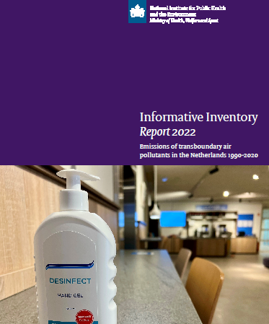
Dutch emission inventory
Every year the ER delivers an unambiguous set of emission figures from 1990 to the present, in line with international guidebooks
International reports of GHGs (CO₂, CH₄, N₂0 en F-gases) and transboundary air pollutants (PM₁₀, PM_{2.5}, NO_{x}, NH₃, SO₂, NMVOS, CO)
Also other components such as heavy metals, pesticides and substances of very high concern (375 in total)
Consortium of RIVM, CBS, PBL, WUR and Deltares under the direction of RIVM; also contributions from RWS and TNO

Slide 3
Emission calculations
Point sources are registered via electronic environmental reports:
Emissions of more than 1000 companies
Registered by the companies themselves
Checked and approved by the local authorities
Diffuse sources: Emission = emission factor x activity data
Emission factors are based on measurements
Activity data are mostly statistical data
The emission inventory uses a bottom-up approach to calculate national total emissions. No comparisons to top-down methods are made.

Slide 4
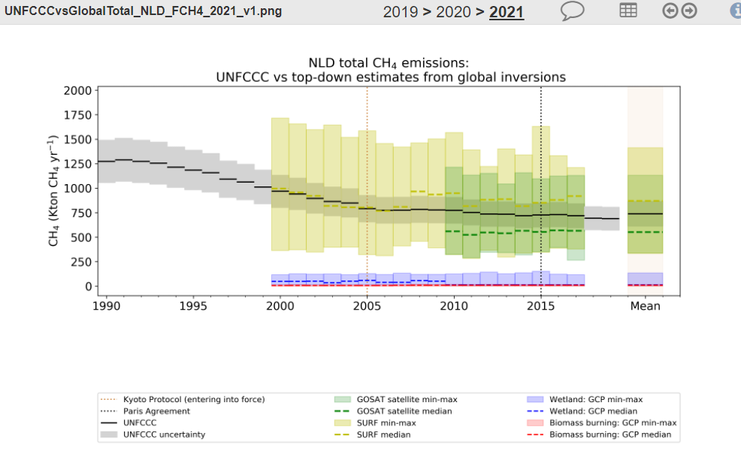
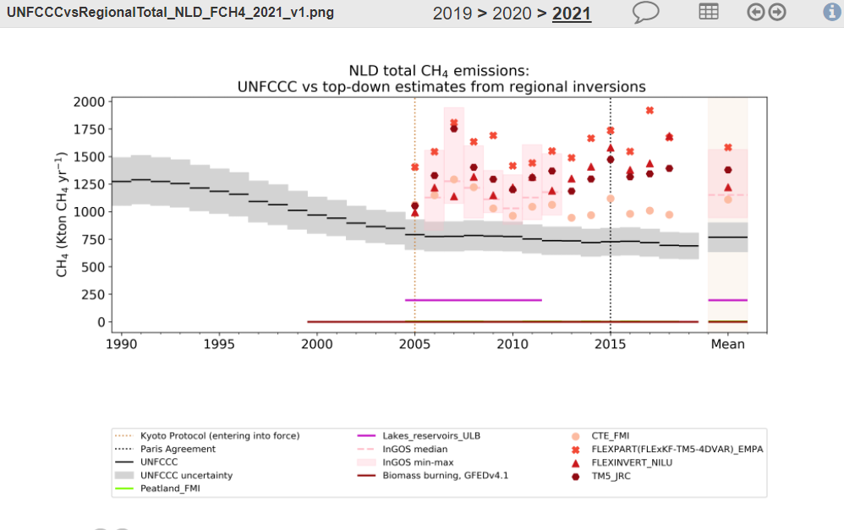
First project: VERIFY
Observation-based system for monitoring and verification of greenhouse gases
First steps on a common journey
Long time series (+)
Huge uncertainties in inversions (-)
Regional inversions show diverse picture, hard to judge for inventories (-)
No direct comparison possible due to different definitions (e.g. natural emissions)

Slide 5
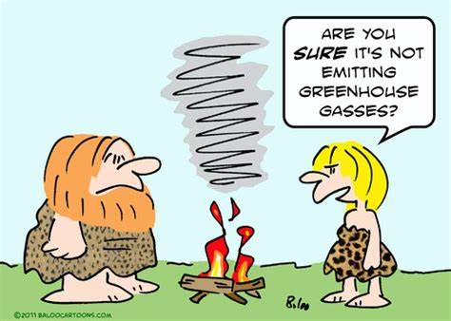
Requirements to take steps forward
Collaboration by scientists across different projects is valuable for creating one ‘scientific tongue’ towards inventories
Agreement over common guidelines will facilitate easy adoption for emission compilers
Extended training of the inventory community is needed to understand the complexity and requirements

Slide 6
Potential and discussion points
Potential
Huge potential to use satellite data for comparisons with emission inventory data for reconciliation purposes
Discussion points
Details in calculated inventory emissions vs what is feasible by inversions
Lack of observational data could be a problem
There are several communities; how to keep them aligned?
How do we ensure cooperation beyond these projects?

Slide 7
In order to make progress all ingredients are needed: inventories, modelling and observations. Lets keep on walking together and make it a rewarding journey!
Thank you

