Slide 1
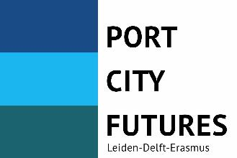
Port cities and health
Led by: Carola Hein
With: Michael Rodrigues, Lukas Höller, Yvonne van Mil

Slide 2
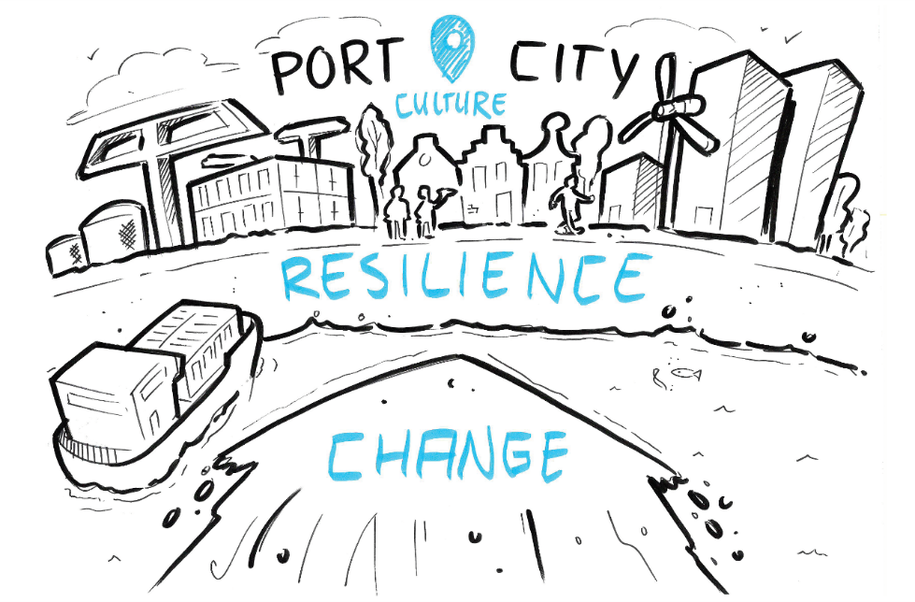
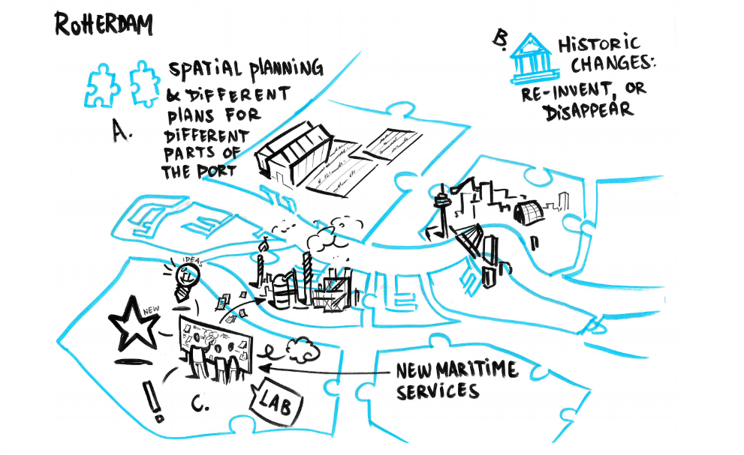

Slide 3
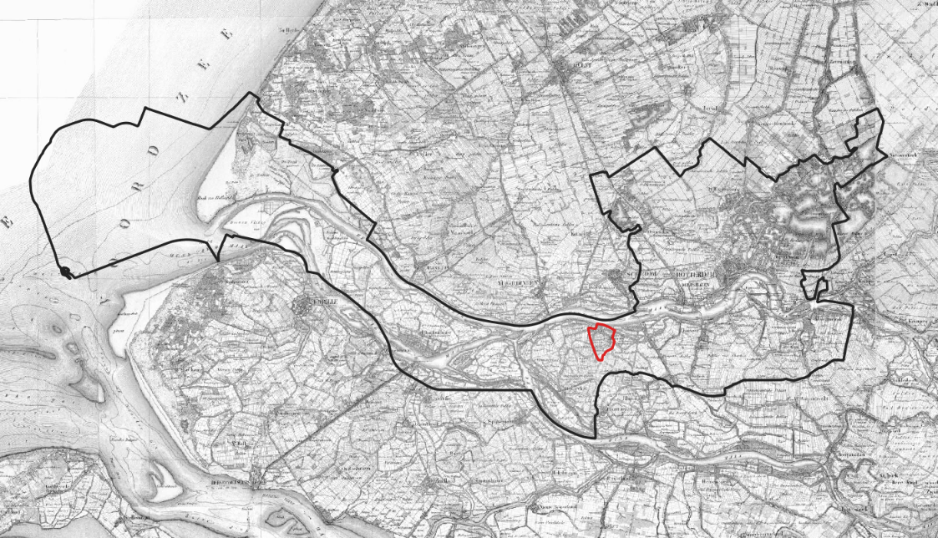
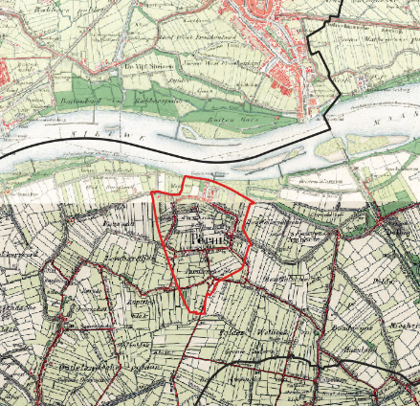
Pernis
From fisher-village to oil-town

Slide 4
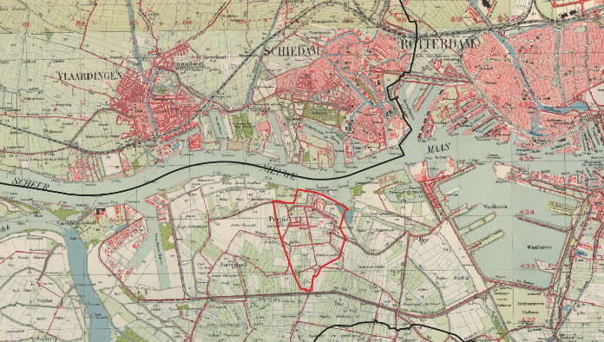
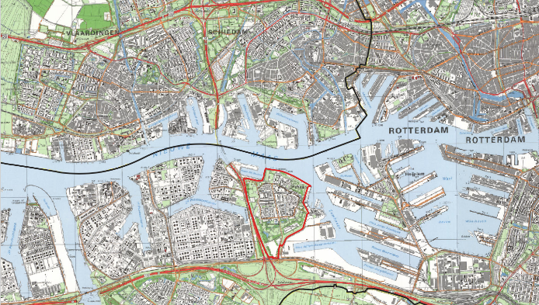
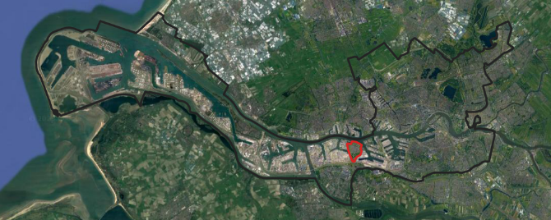
Pernis in around 1930
Source:©Topotijdreis in QGIS, own graphic
Pernis in around 1990
Source:©Topotijdreis in QGIS, own graphic
Source:©Google earth in QGIS, own graphic

Slide 5
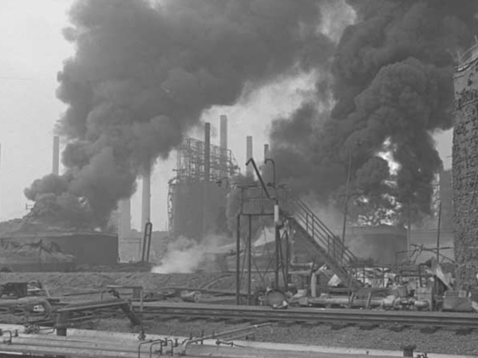
Shell Pernis - Blessing and Curse?
Explosion at Shell Pernis of 1968, one of the largest accidents in the port of Rotterdam.
Plof van Pernis - Brand Shell in 1968
Source:©Gemeentearchief Rotterdam - Ary Groeneveld

Slide 6
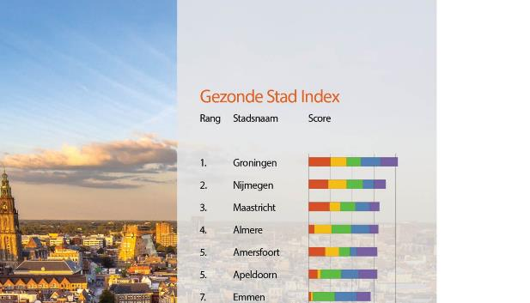
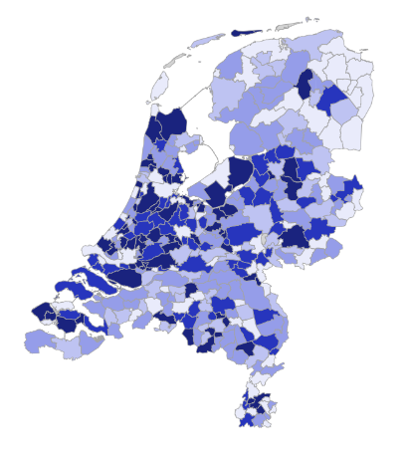
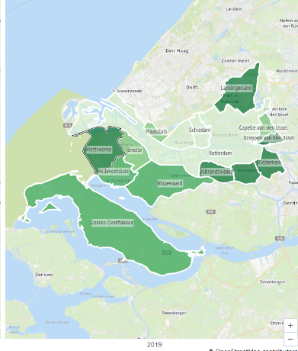
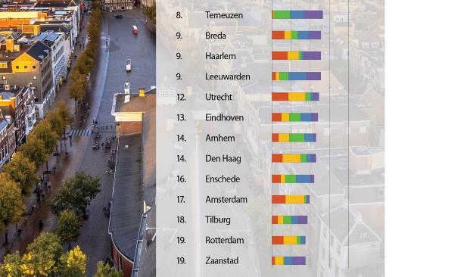
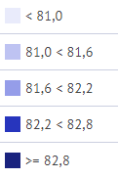
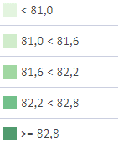
Levensverwachting, 2019, Gemeente
Source:©RIVM
NL: 82,1 Years (2019)
Rotterdam: 80,3 Years (2019)
Gezonde Stad Index, 2022
Source:©ARCADIS
Oil and gas facilities in Rotterdam are one of the main polluters of the region.
Rotterdam is one of the unhealthiest cities in the Netherlands.
The port of Rotterdam is the most polluting port in Europe.

Slide 7
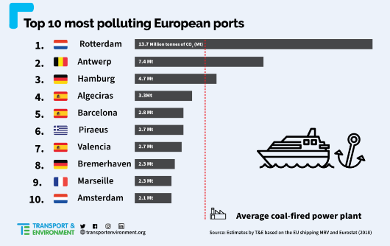
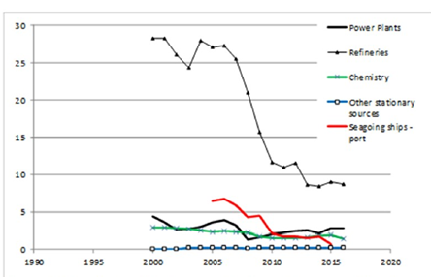
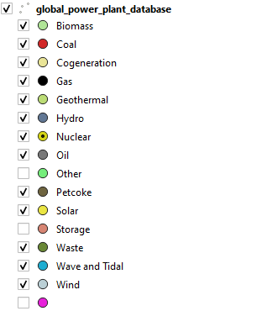
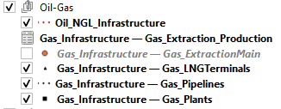
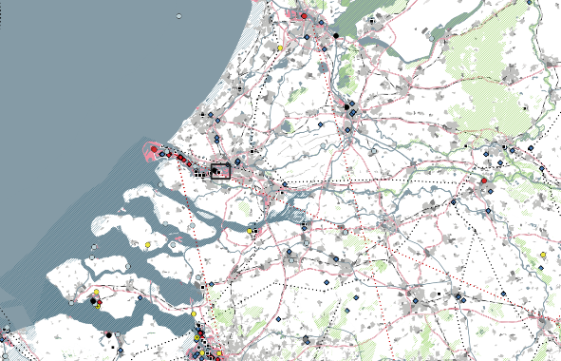
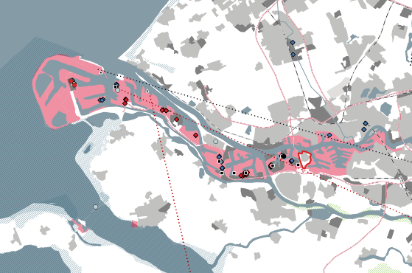
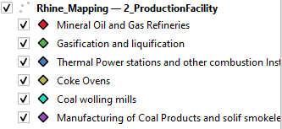
SO2 emission (kton/year) trend of the main sources within the port of Rotterdam area
Source:©Gemeentearchief Rotterdam - Ary Groeneveld
Global Power Plants and main fuel, European Oil/Gas Infrastructure, E-PRTR Facilities
Source:Global Energy Observatory, Google, World Resources Institute. 2018. Global Power Plant Database;
EuropeGasTracker - Global Energy Monitor (2022); The European Pollutant Release and Transfer Register (E-PRTR)
14 million tonnes of CO2 each year, which is more CO2 emission than 3 average coal-fired powerplants together.

Slide 8
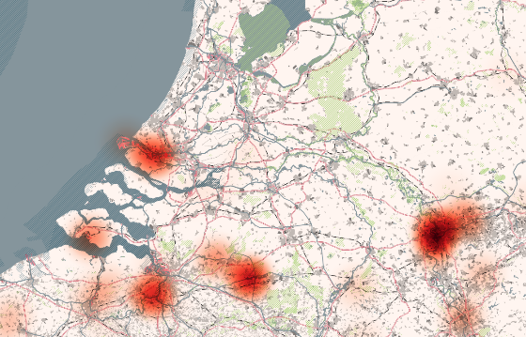
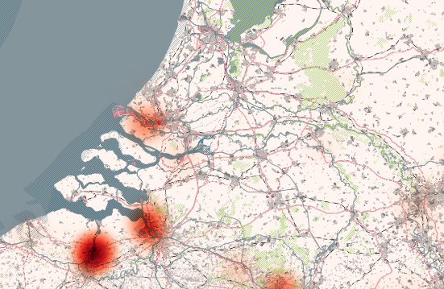
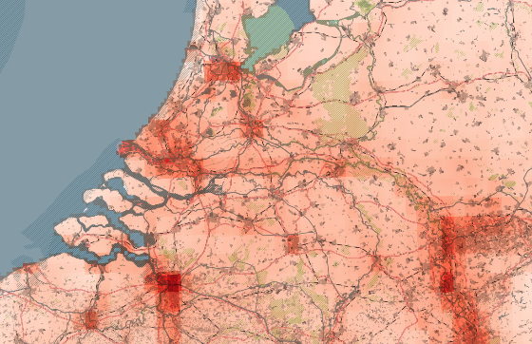
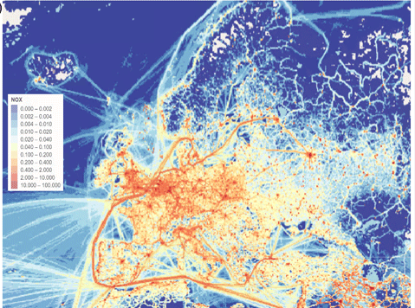
SOx Pollution from E-PRTR Facilities
CO2 Pollution from E-PRTR Facilities
NOx Pollution total
NOx Pollution Shipping
2017 CAMS-REG-v4 (Kuenen et al. 2022)

Slide 9
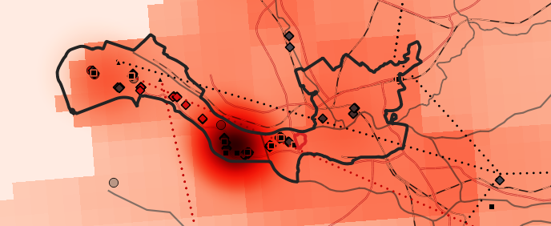
Pernis must be super unhealthy! It is right in the ‘Epicenter of Pollution’

Slide 10
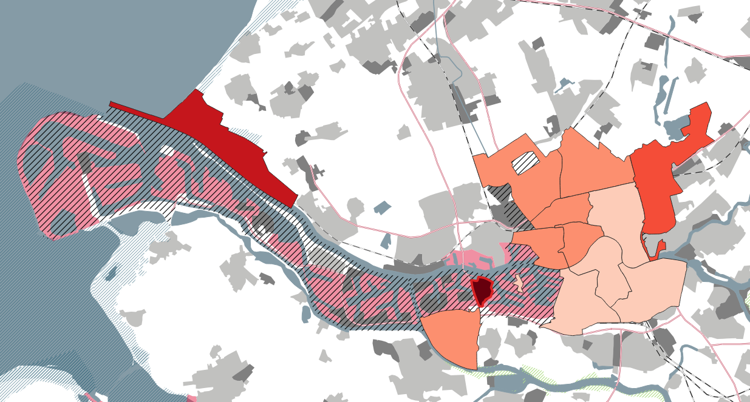
Pernis must be super unhealthy! It is right in the ‘Epicenter of Pollution’
BUT it’s not?!
NL: 81,56 Years (2016)
Rotterdam: 80,3 Years (2016)
Pernis: 83,7 Years (2016)
The impact on health of the Port is NOT bound to the local, but rather has to be investigated on a broader territorial scale.
Looking at singular homogenous data doesn’t give a clear answer to the issue.

Slide 11
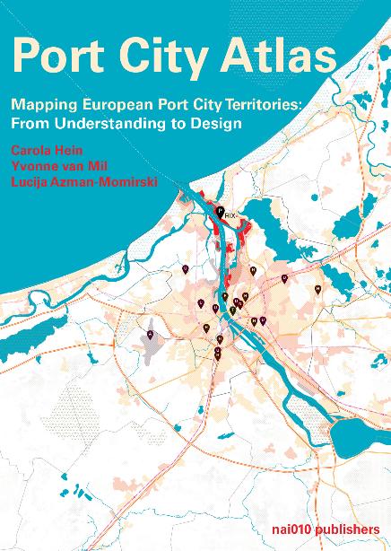
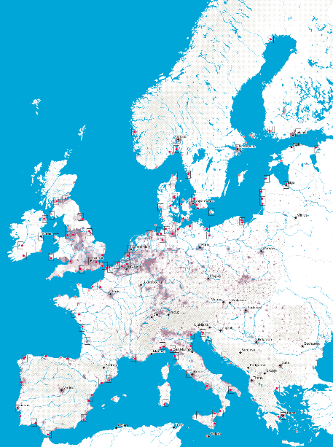
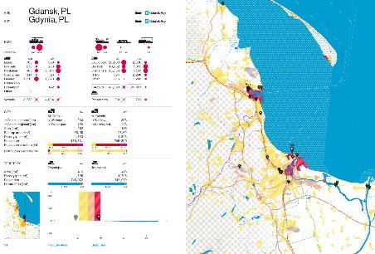
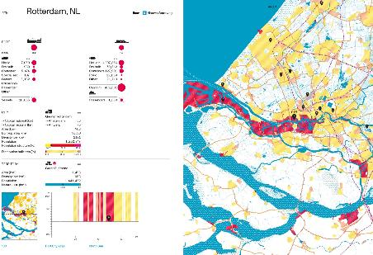
Mapping as a way to study the port city territory
Source: Carola Hein, Yvonne van Mil, Lucija Azman-Momirski (2023). Port City Atlas. Mapping European Port City Territories: From Understanding to Design. Rotterdam, NAi010.

Slide 12
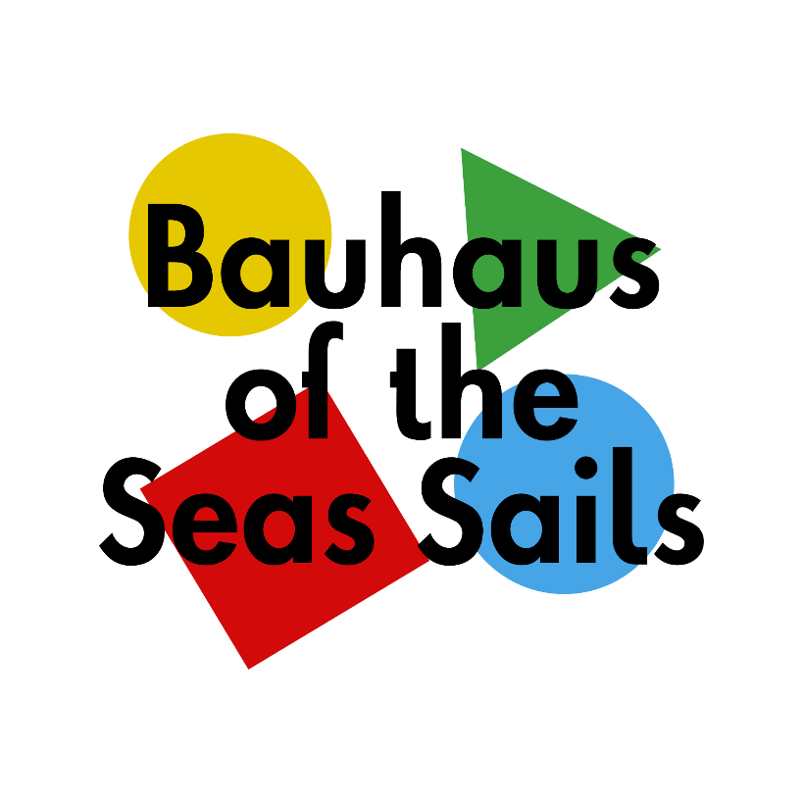
We are developing a geospatial platform for a European research consortium that covers several port city regions.

