Slide 1
FANFAR: Reinforced cooperation to provide operational flood forecasting and alerts in West Africa
Aytor Naranjo, Lobelia/isardSAT
and the FANFAR consortium
Benin, Burkina Faso, Cap Verde, Chad, Gambia, Ghana, Guinea, Guinea-Bissau, Ivory Coast, Liberia, Mali, Mauretania, Niger, Nigeria, Senegal, Sierra Leone, Togo, NBA, VBA, OMVG, CBLT, ECOWAS, WMO
Notes:
Acknowledge the FANFAR team & partners, mention also countries/organisations!

Slide 2
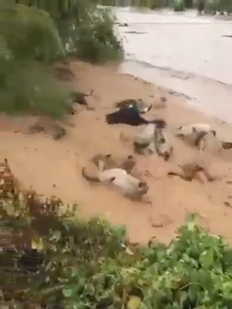
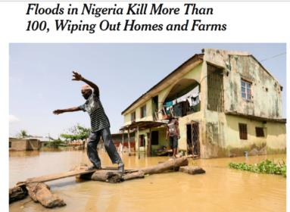
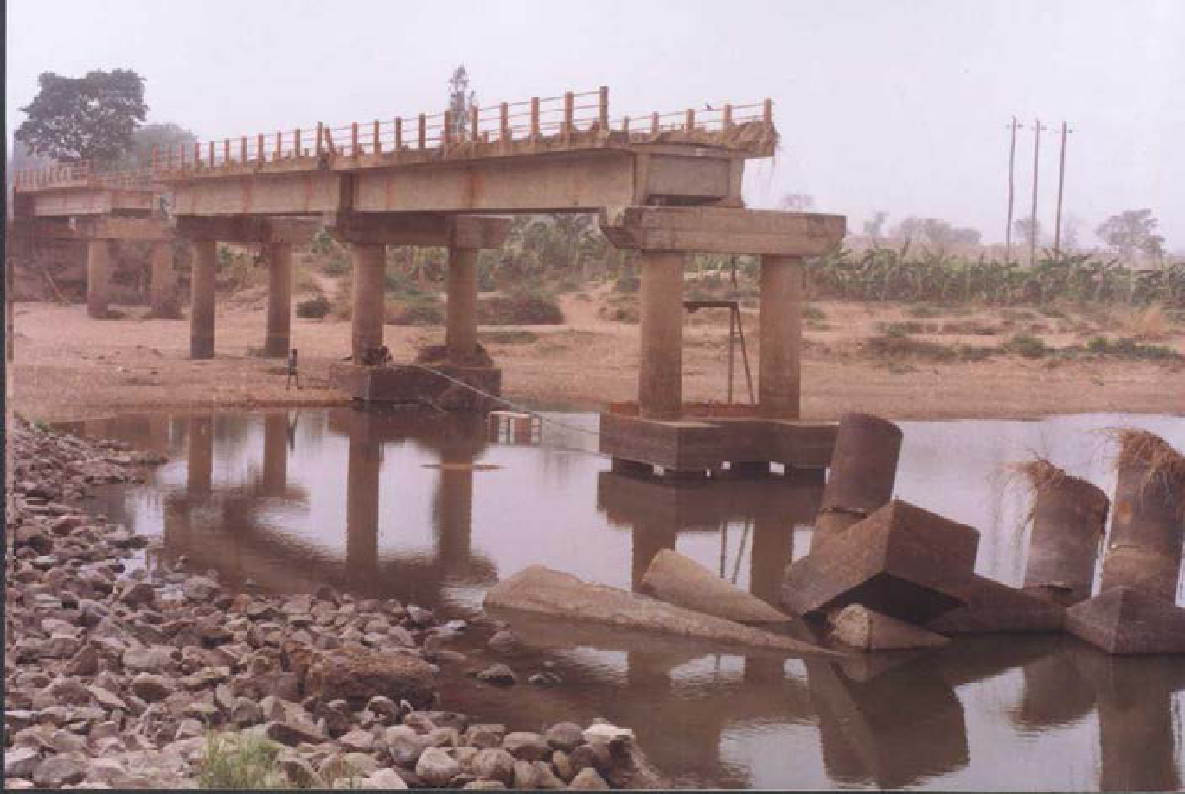
Motivation
Several floods in West Africa: 2020, 2019, 2018, 2017, 2016, 2012 …
Serious consequences: lives lost, economic damages, millions affected
Climate change → increased floods
Key need: accessible and up-to-date flood forecasts & alerts
2020
2018
2010
https://www.nytimes.com/2018/09/17/world/africa/nigeria-floods.html
Notes:
why

Slide 3
The FANFAR project
Research & Innovation project financed by European Commission (2018-2021)
Vision
Resilient societies, minimum flood impacts, capable institutions
Forecasting system operated by regional & national West African institutions & partners
Overall aims
Provide a pre-operational flood forecasting & alert system at West African scale (updated every day)
Reinforce cooperation between West Africa and Europe → building system together!
Notes:
what

Slide 4
FANFAR objectives
System should be:
Co-designed: working group defining prioritized needs
Co-adapted: jointly modified & developed according to needs
Integrated: all components working together
Co-operated: jointly operated and maintained
Provide reliable and timely access to information
Robust ICT, relevant for West African conditions (electricity, internet etc.)
Sustainably financed & maintained
Co-designed system
Co-developed system
Integrated system
Co-operated system
Accessible & timely system
Robust ICT
Sustainability
Notes:
Parable/liknelse: integrated system: car components, but also the road, the driver and the fuel

Slide 5
Key achievements

Slide 6
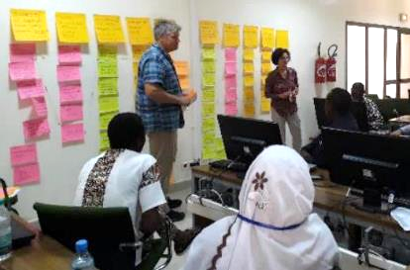
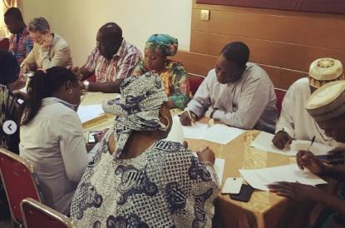
Co-design: what would a “good” system be?
4 workshops in West Africa & online
>30 organisations from 17 countries
Clarify & prioritize user needs with MCDA
Analyse behaviour & experiences
Niamey, 2018
Abuja, 2020
Notes:
Add GENDER here # male/female?

Slide 7
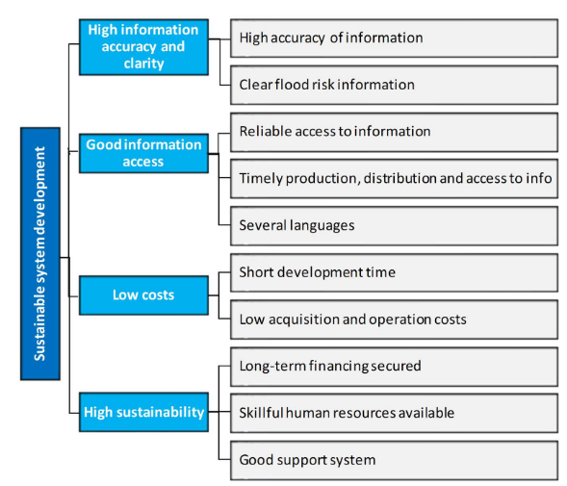
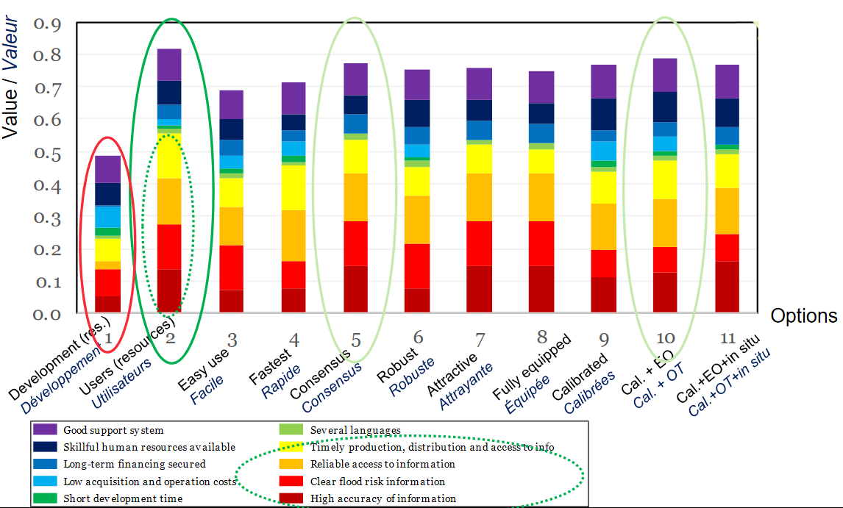
Co-design: what would a “good” system be?
Objectives
Options
Priority: operational system > advanced features
Stakeholders

Slide 8
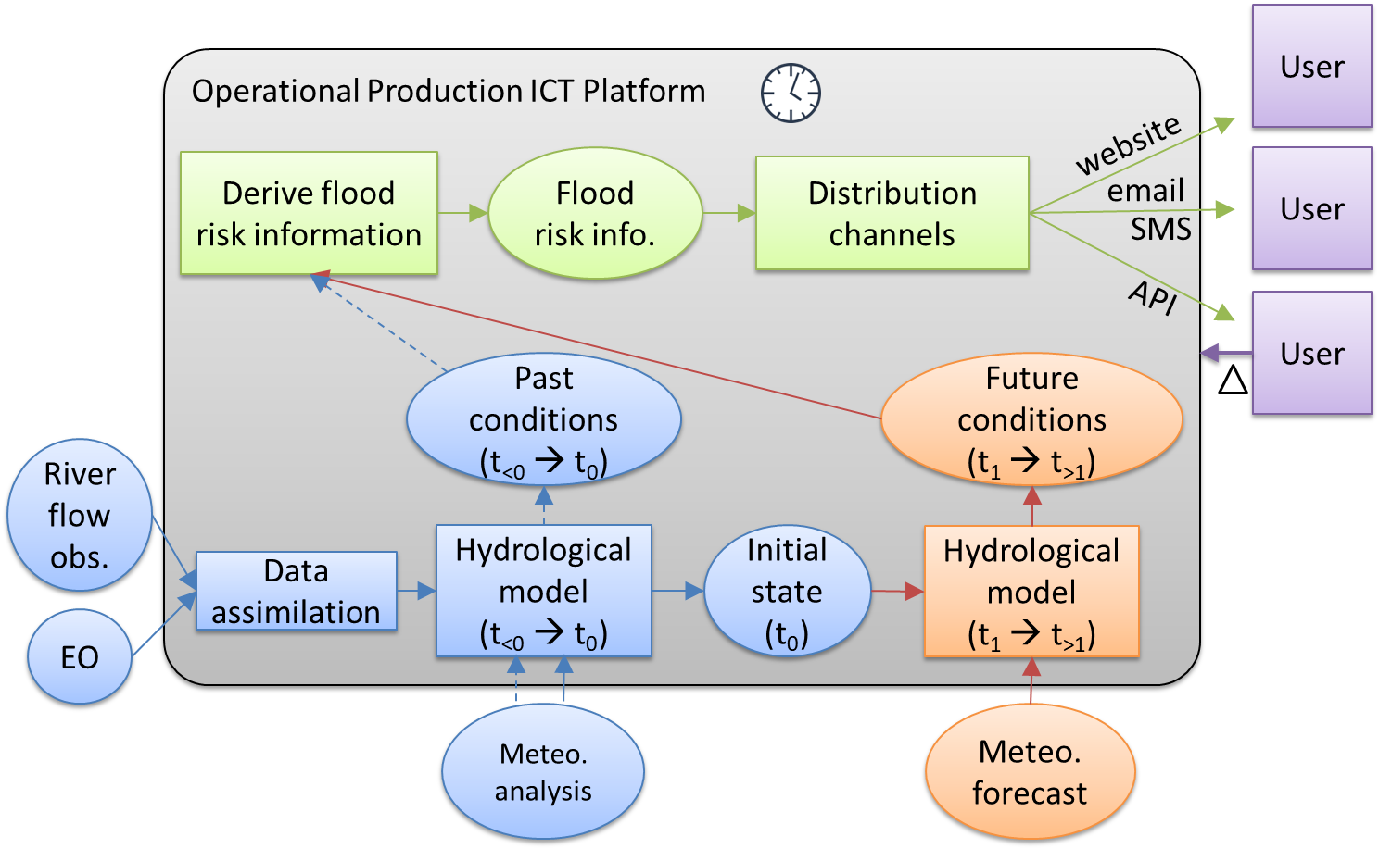
Operational flood forecasting & alert system for West Africa
Hydro model (rainfall-runoff):
Niger-HYPE
West Africa (WWH)
Initialisation/spin-up (blue)
to get a state representing current conditions
Need meteo. ’analysis’ (model + obs. of near-historic time, e.g. 30last days)
Data assimilation (river flow, EO)
Forecast of future, using meteo forecasts (orange)
Information derivation
Process output data to e.g. alerts (current conditions vs. relevant alert level thresholds for a given area)
Distribution
One-way
Two-way
Simple to complex data
Operational production cloud platform (OPCP): scheduled, automated execution and monitoring = Hydrology-TEP
Openly accessible 1-10day forecasts
Updated every day since Sep. 2018
Developed jointly & continuously

Slide 9
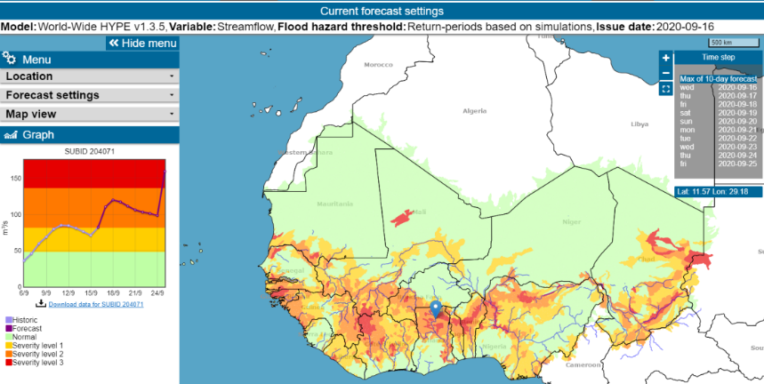
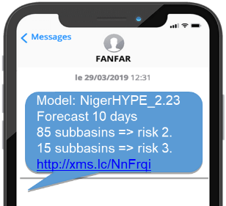
Distribution channels
Website
Email
SMS
Machine-to-machine API

Slide 10
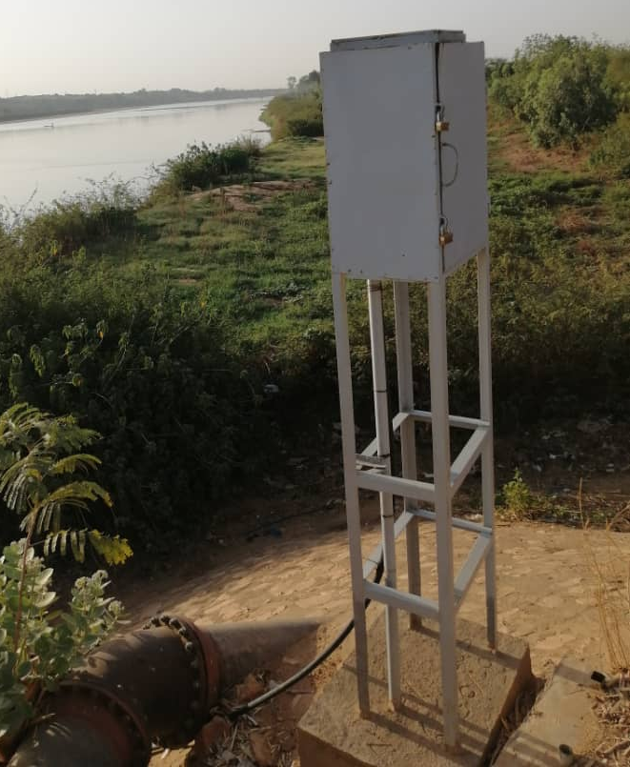
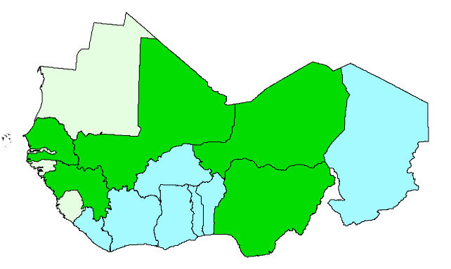
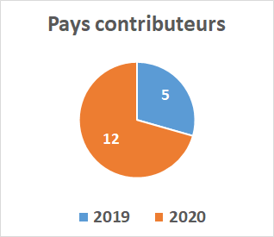
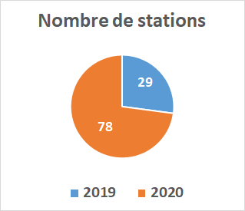
Local observations
Water level & discharge from local stations
Regular collection, formatting, quality control, FTP upload
Challenge: keep it operational
Contribution 2020

Slide 11
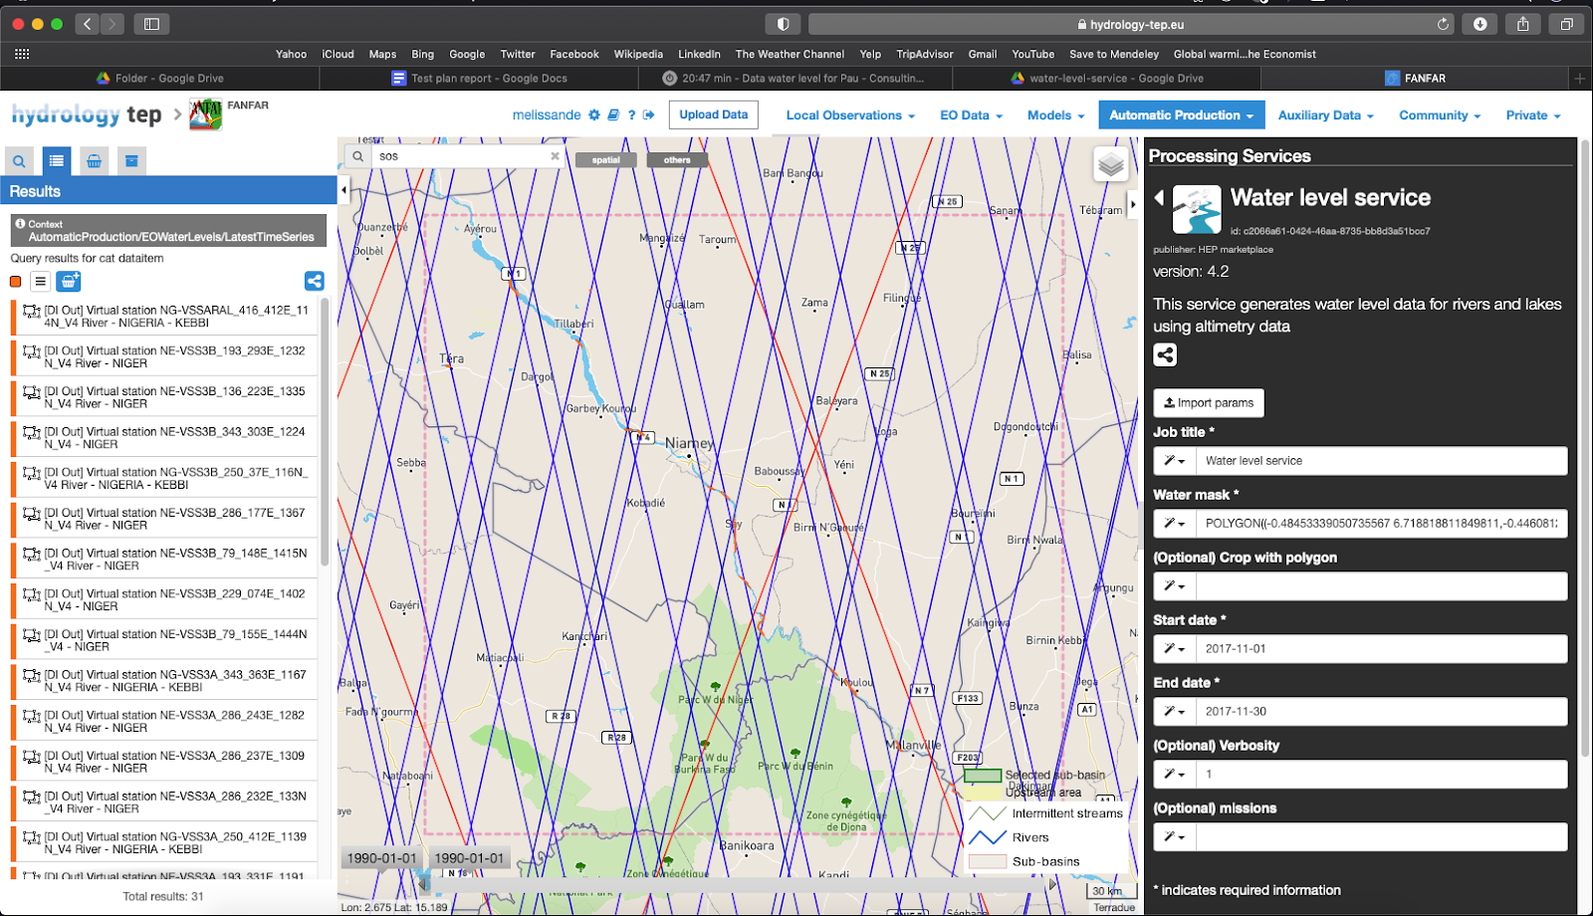
Water level from satellite data

Slide 12
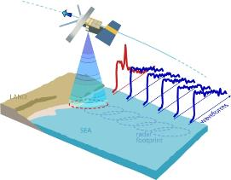
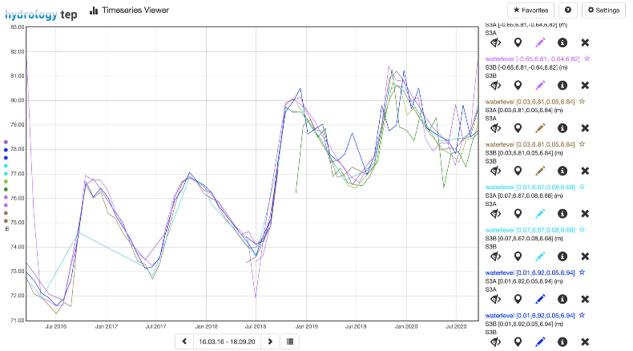
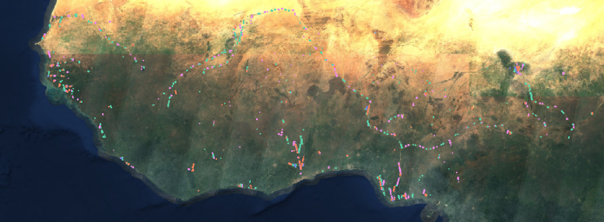
Water level from satellite data
1078 virtual stations from multiple sattelite altimetry missions
Data since 2001, updated automatically
Ongoing validation with >30 local stations

Slide 13
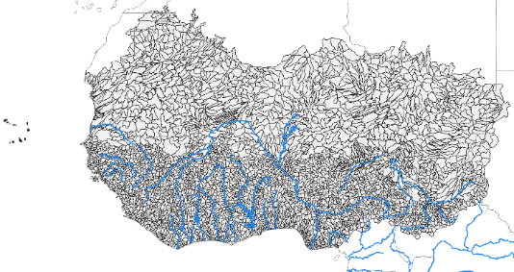
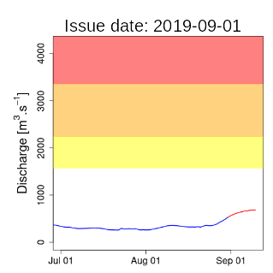
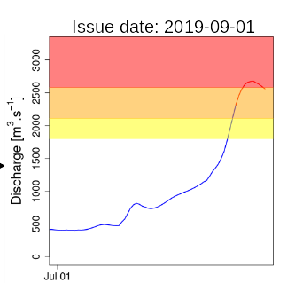
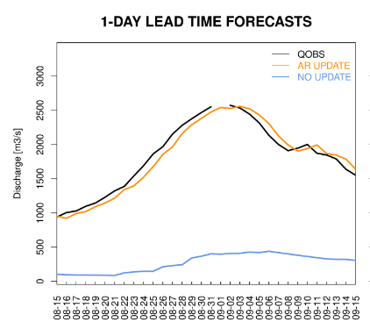
Hydrological modelling
Catchment delination
Calibration & catchment delineation
Multiple models: WWH 1.3.5, Niger HYPE 2.30, West Africa HYPE 1.2
Assimilating local observations
Improved meteo. data cascade
Variables: streamflow, water levels, precipitation etc.
Daily forecast production
Recalibration
Assimilation

Slide 14
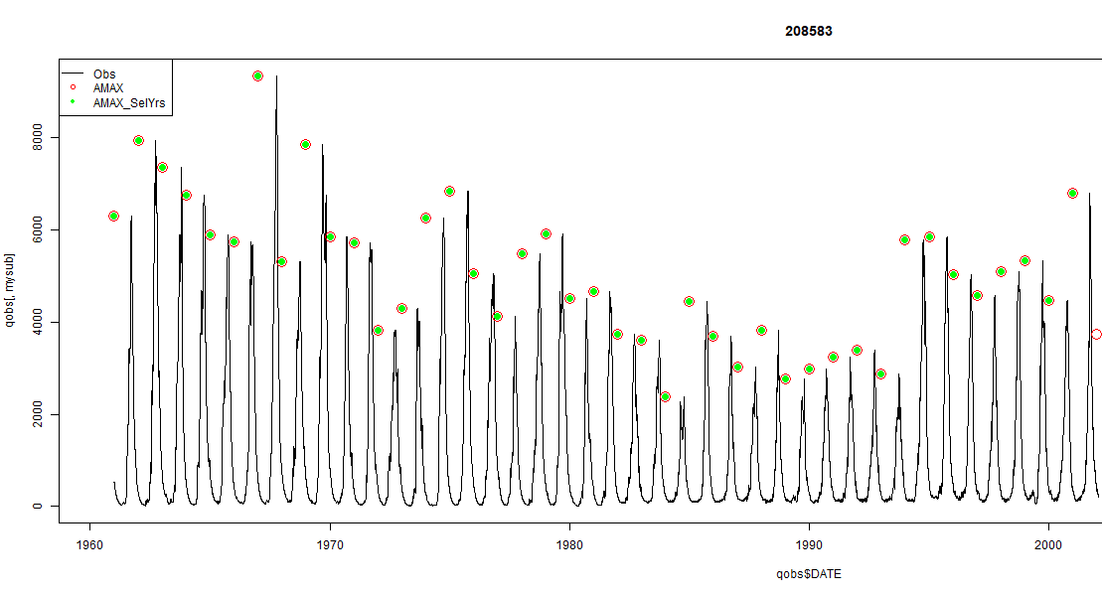
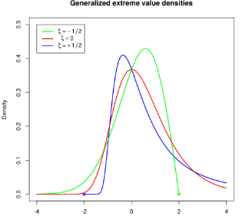
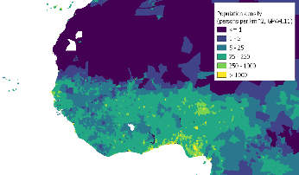
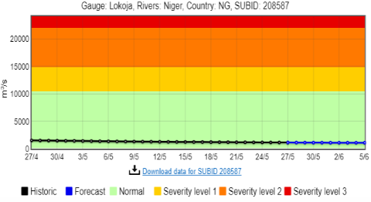
Flood risk information derivation
Flood thresholds:
peak flow frequency (return periods)
% of historic year
Local thresholds
Impacts: population affected

Slide 15
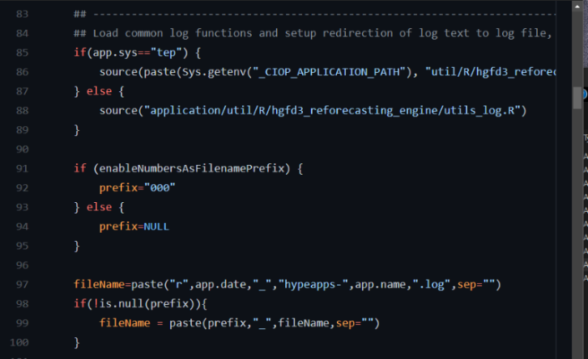
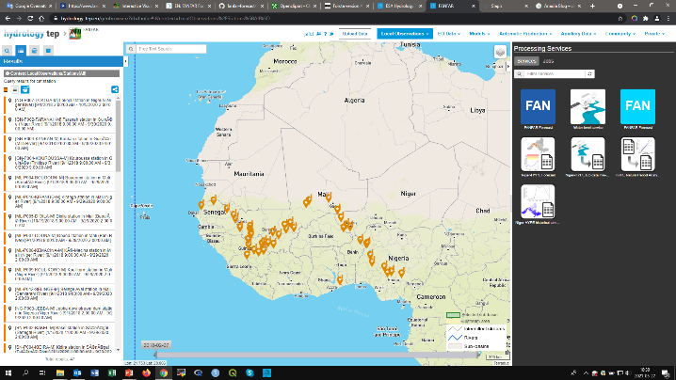
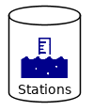
ICT platform for operational production
https://hydrology-tep.eu/
Automatized → code executed on cloud computing platform
Version control & standards
24/7 data flow & monitoring
Interactive processing
Community

Slide 16
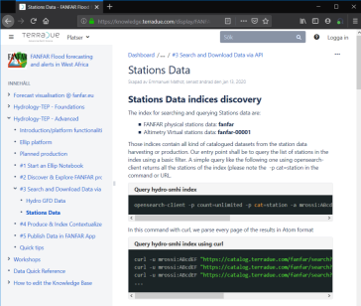
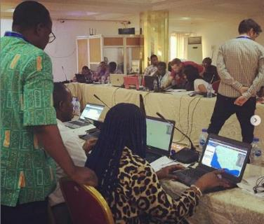
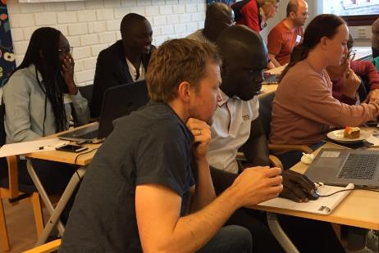
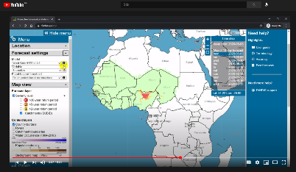
Capacity development & support
Hands-on training in workshops, in-depth courses, expert exchanges, bi-weekly meetings
Open multi-lingual training material & documentation: Knowledge base (wiki), YouTube, WhatsApp group, Forum, Help Desk, Email
MSc courses at AGRHYMET, PRESASS, ECOWAS DRR, UN-SPIDER
Nigeria, 2020
Sweden, 2019

Slide 17
System performance & experience of West African agencies

Slide 18
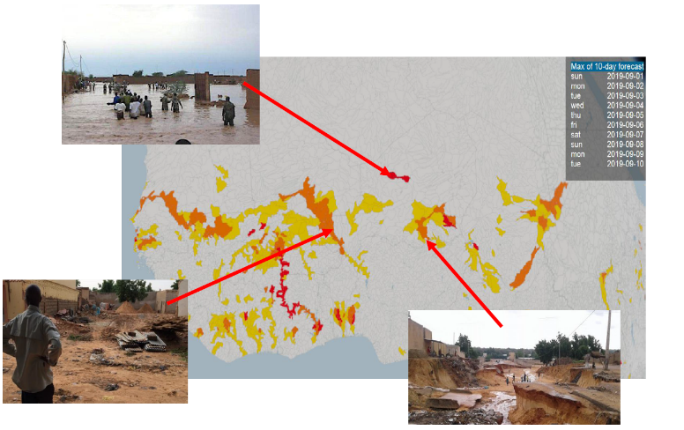
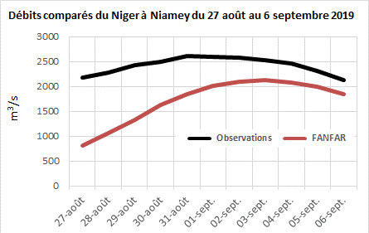
Forecast vs. reality: 2019
Reality: lives lost, displacements, damaged infrastructure etc.
Forecast performance: varied, good timing & location of peaks ( ± 1-2 days), underestimated peak magnitudes (-5-50%), minor false alarms

Slide 19
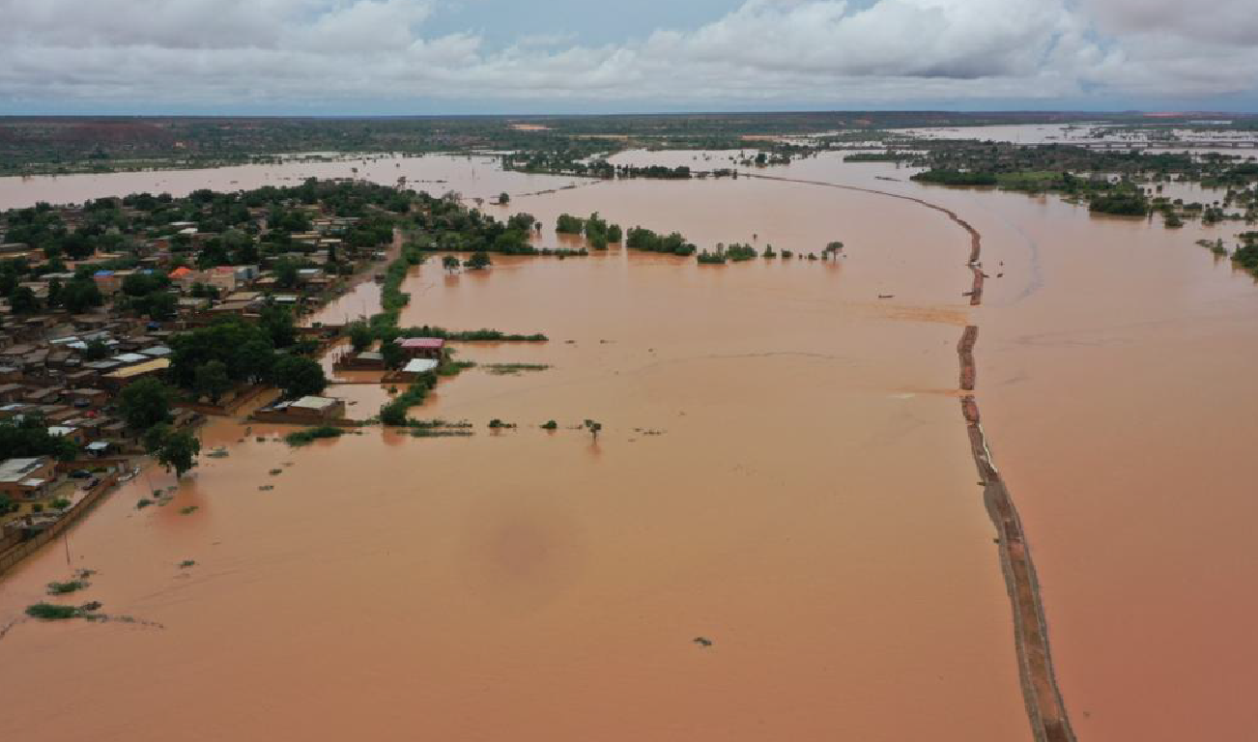
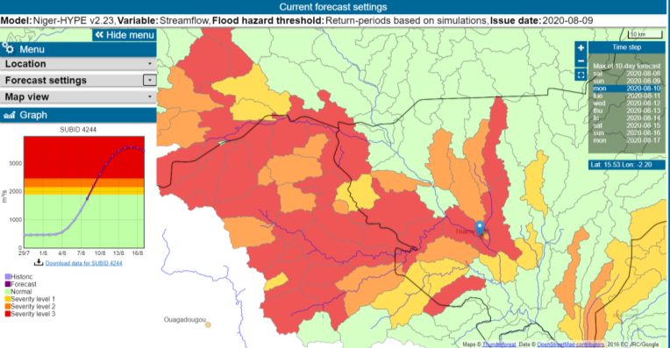
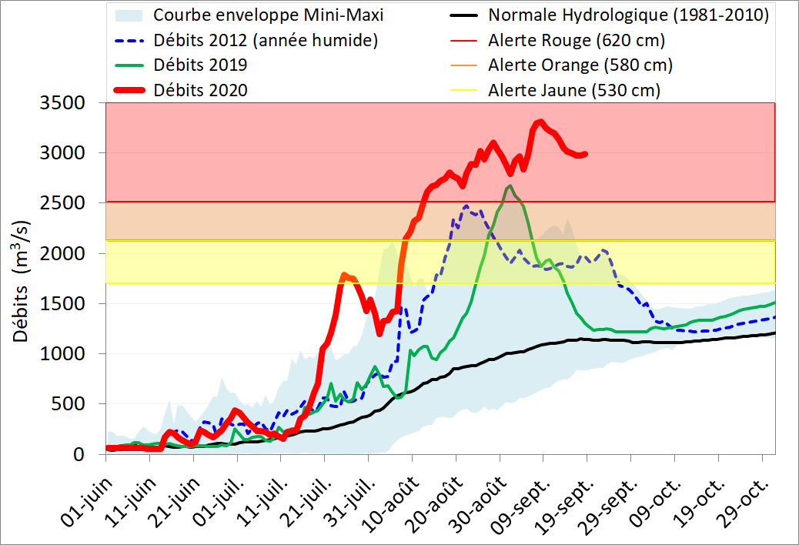
Forecast vs. reality: Niamey, Niger, 2020
Worst flood in 100 years
www.slapis-niger.org , 2020-09-10
Consequences: 71 victims & 350 000 affected, 1441 ha agriculture, etc.
FANFAR performance: Timing & severity well captured, but duration underestimated
Collaborative evaluation by West African agencies and FANFAR partners live & retrospectively
Local observations

Slide 20
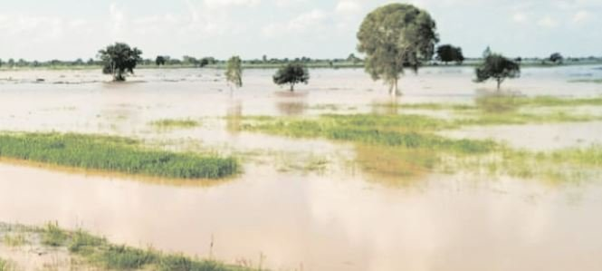
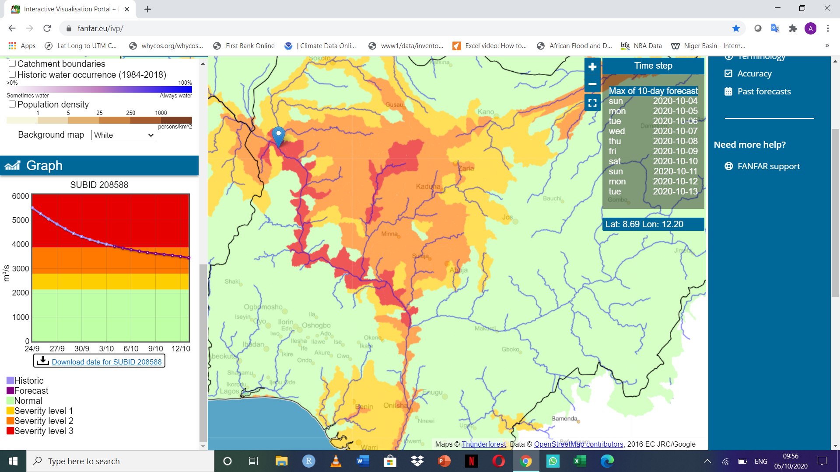
Country-level feedback: Nigeria - NIHSA
2020 flooding | 35/36 states affected
Consequences | 126 deaths, 48,114 persons displaced and 29,356 houses destroyed
Multiple institutions → harmonization efforts like FANFAR needed
Accurate severity levels at all stations (even if discharge magnitudes need to be improved) → FANFAR used by NIHSA since 2020
Component in annual budget
Oct. 2020: Forecast: severity levels 1-3 in Kaduna & Niger Rivers 🡪 Reality: Flooding around Shiroro dam and Niger axis

Slide 21
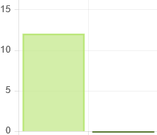
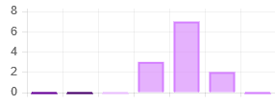
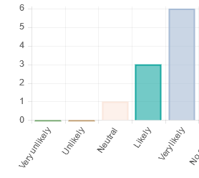
Experience of West African agencies 2020
Current accuracy of FANFAR
Future use if accuracy remains the same?
Overall likelihood of using FANFAR in future
Worst
Bad
Good
Best
Yes
No
Very bad
Neutral
Very good
“The system is good. However, the false alerts should be minimised“
“Problems with login to ICT platform”
“Great job done. Keep doing what you do best.”
Notes:
Selected results, comprehensive analysis long/coming later.

Slide 22
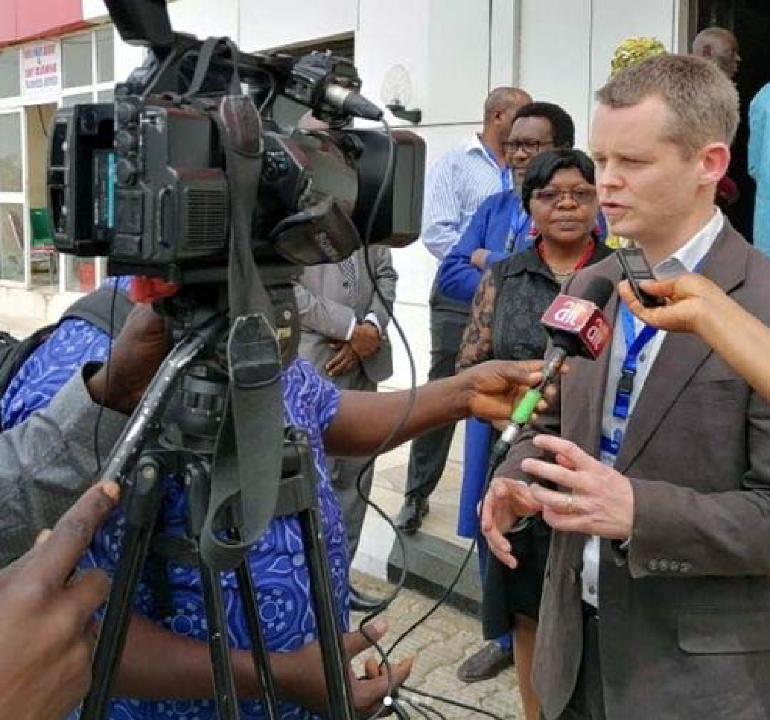
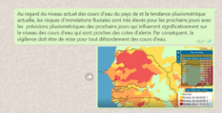
FANFAR already used beyond project
National scale: bulletins, social media, TV, newspapers to stakehodlers
Regional scale: ECOWAS flood observatory
Local scale: Sirba river EWS in Niger
Peace-keeping
UN MINUSMA, Mali
Notes:
Mention prospects within VoltALARM and CREWS Togo

Slide 23
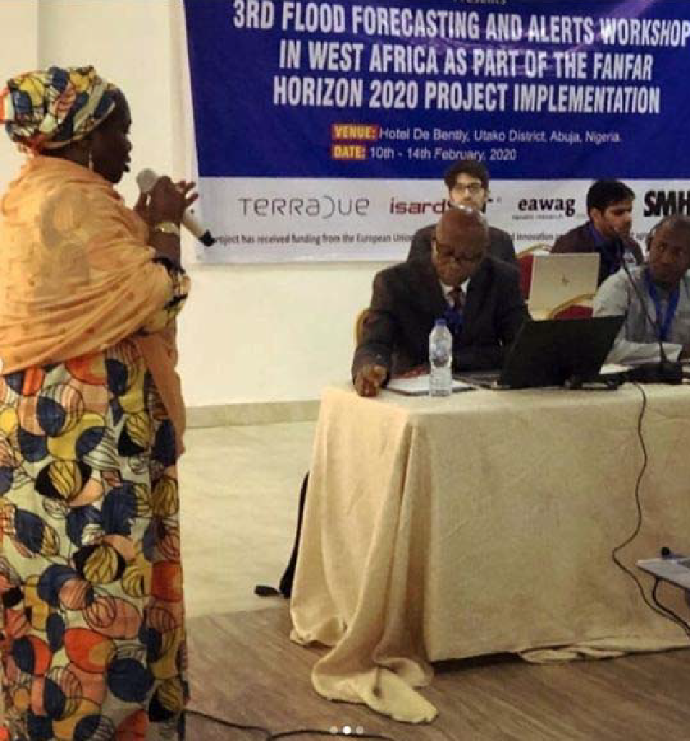
Towards sustainability
Tandem agile approach:
Operate current system → societal value
Advance system & capacity
Capacity development: knowledge, know-how, gender balance
Collaboration: co-design, co-development & co-operation
Open: open-source tools, data, documentation & training
Accuracy & coverage: combination of observations and models across domain, continuous refinement, incorporate local knolwedge
Reliable access & production: web & SMS access, cloud ICT, up-to-date production, stable partners

Slide 24
Current situation and way forward
Forecast produced in-house at SMHI since Jan 2022
EO-based water level data produced operationally in the whole basin with an unprecedented number of virtual stations
Actively looking for funding
Almost unique pre-operational service covering the Niger River basin and producing 1-10 day flood forecasts and alerts daily combining EO and in-situ
High social impact
Relatively low maintenance cost
Strong collaboration between stakeholders and willingness to have the system available

Slide 25
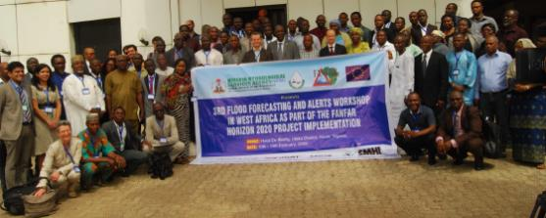
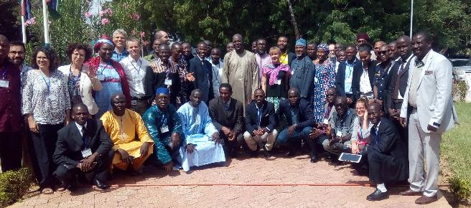
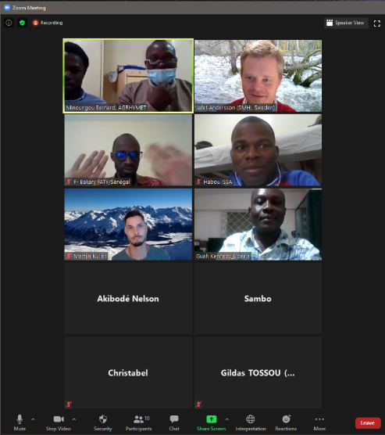
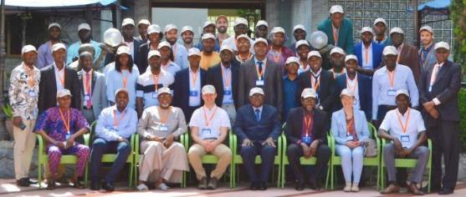
THANK YOU!
Norrköping, 2018
Abuja, 2020
Niamey, 2018
Online, 2021
Accra, 2019

