Slide 1
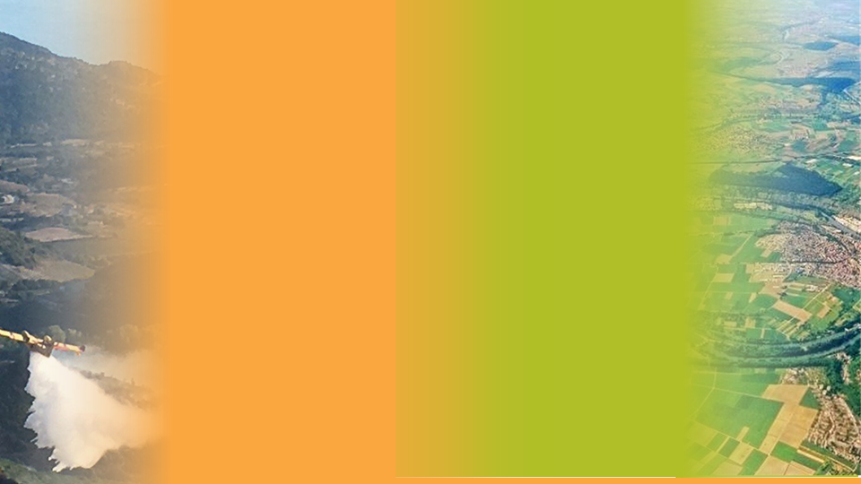


Water products under Copernicus:
&
Emergency
Land monitoring
Water-ForCE webinar “Copernicus for Africa”
Presented by Milan Kalas on behalf of the CEMS & CLMS
30 March 2022

Slide 2
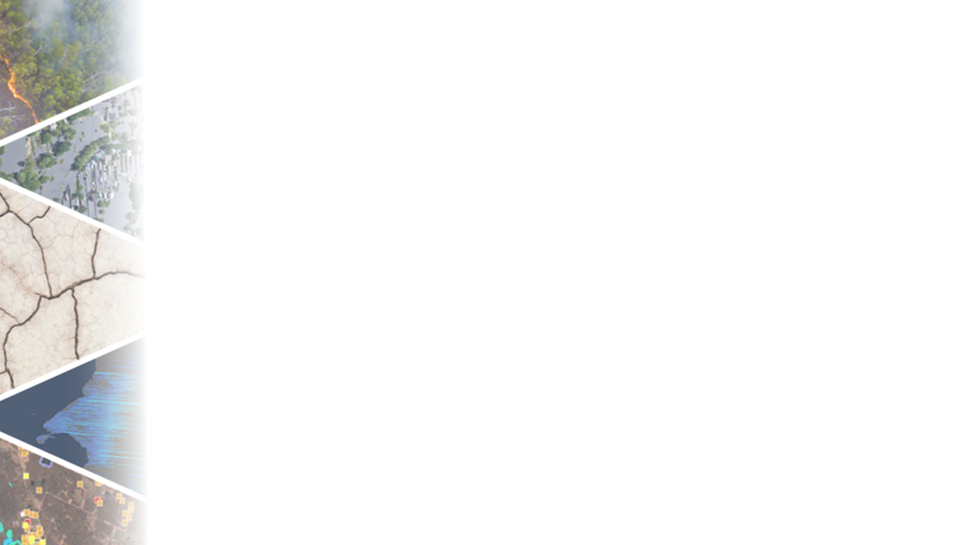
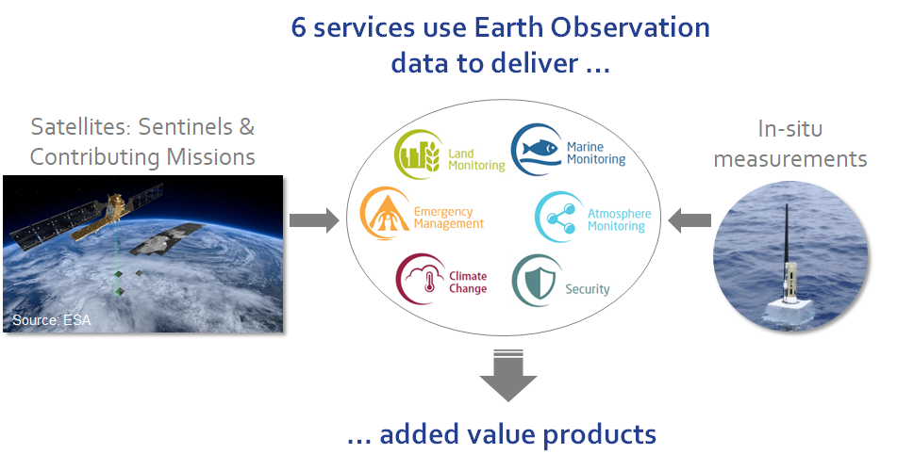

Copernicus
EU's Earth Observation Programme

Slide 3


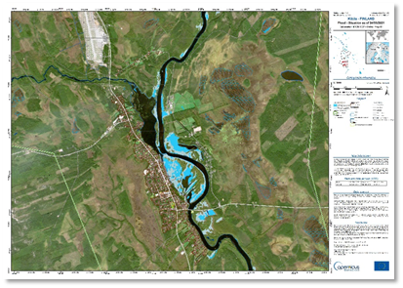
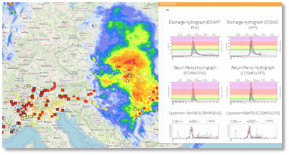
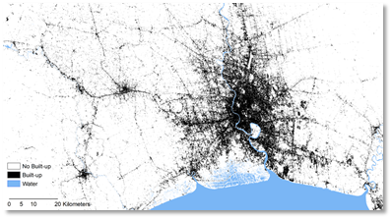
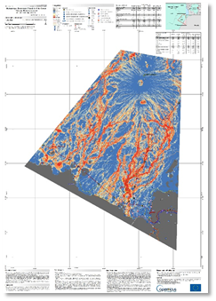
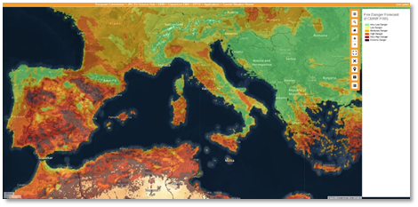
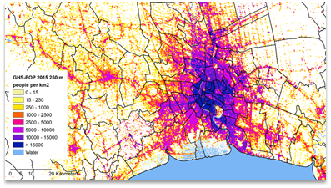
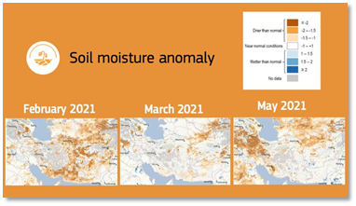
Existing water-related products and services under CEMS
For Whom?
  European Emergency Response Coordination Centre (ERCC)
  Global Disaster Alert and Coordination System (GDACS)
  International aid organizations, EEAS, UNCCD, etc.

Slide 4
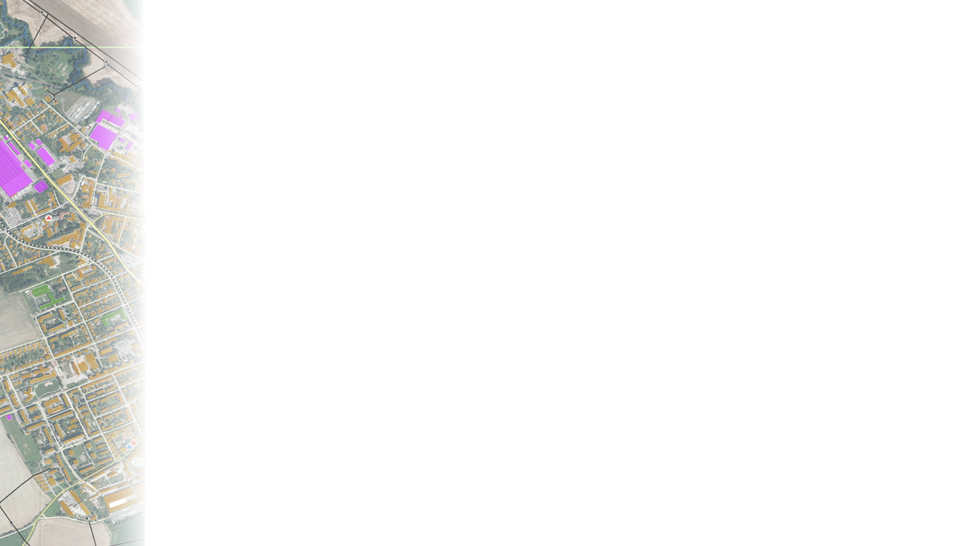



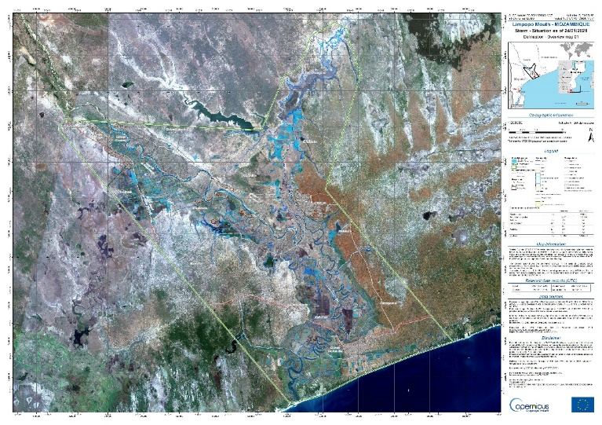
On-Demand Mapping – Water products
Water-related products:
Flood extent and impact maps
Historical flood delineation
Tsunami risk assessment
CEMS on-demand Mapping
(Authorised user needs to request product)
https://emergency.copernicus.eu/mapping/
Risk and Recovery Mapping: products available usually within a few weeks with the aim to support risk prevention and recovery efforts
Rapid Mapping: fast provision of products (hours to a few days) with the aim to support emergency response
Tropical Cyclone Eloise 22-23 January 2021, Mozambique
Rapid mapping of flooded areas
Post-event analysis

Slide 5
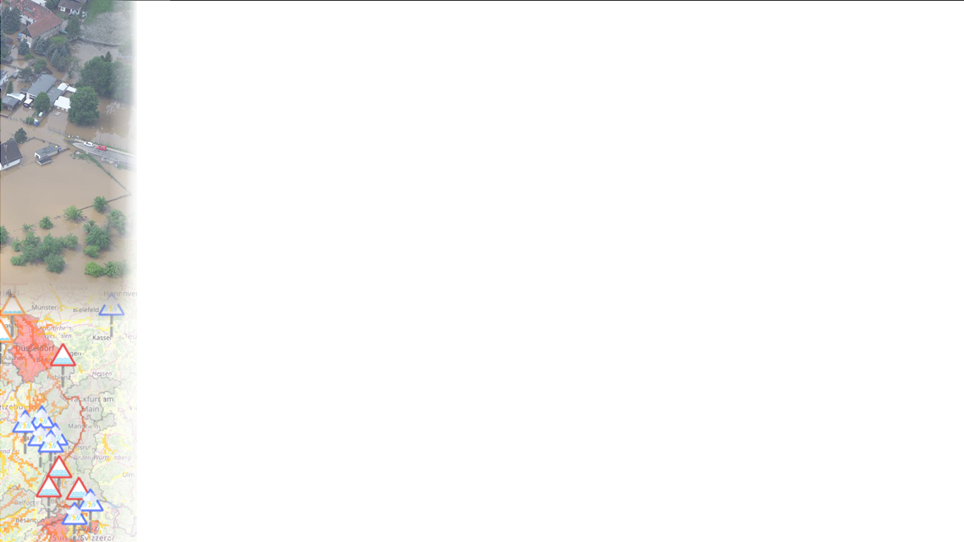

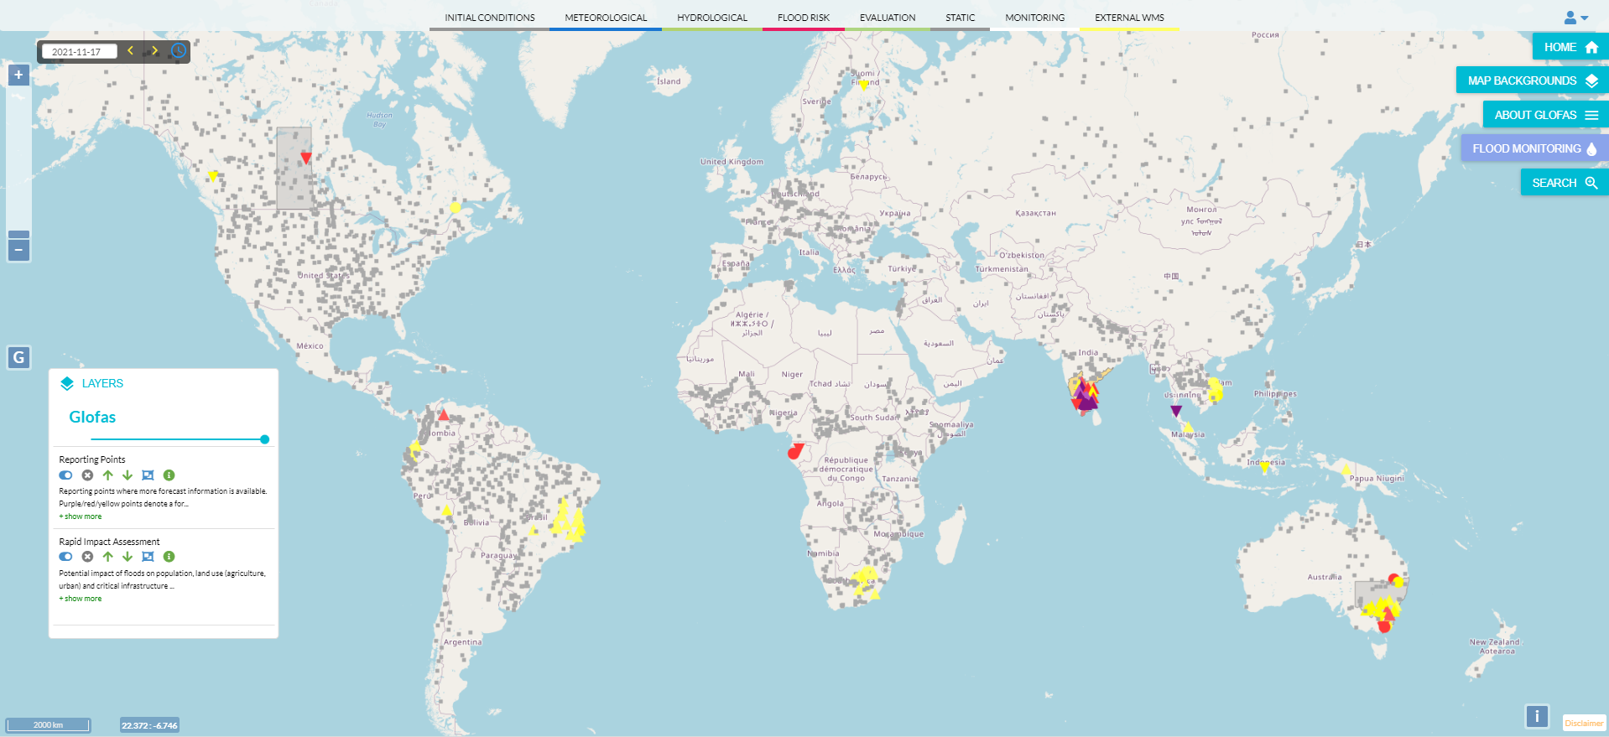
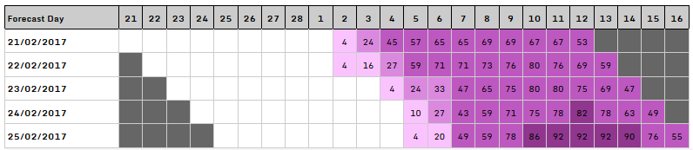
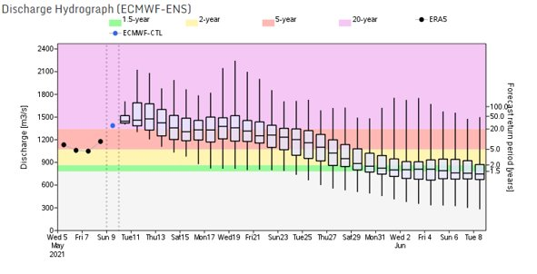
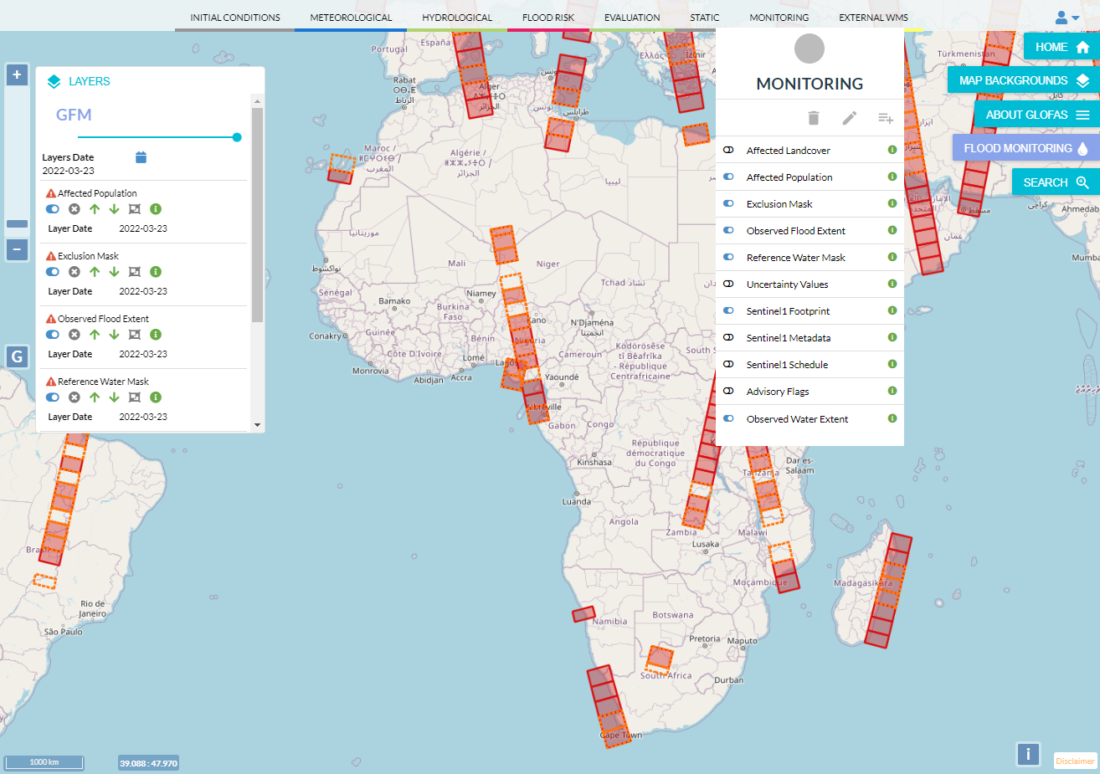
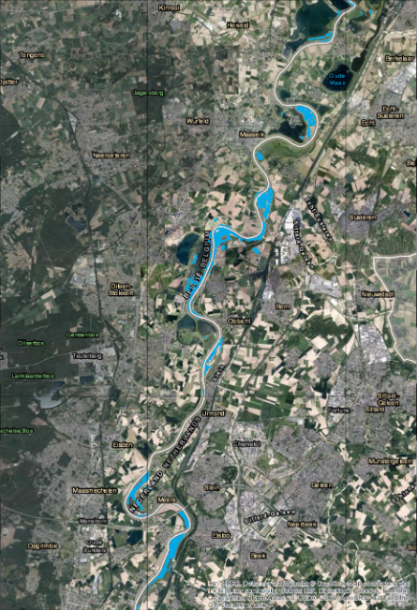
CEMS Flood forecast and monitoring service
https://www.globalfloods.eu/
GloFAS = Global Flood Awareness System
GFM = Global Flood Monitoring
GloFAS and GFM provide:
Global hydrological ensemble forecasts updated daily
Highlights of expected flooding and associated flood risk level over next 30 days
Seasonal hydrological outlook showing wet/dry anomalies over next 16 weeks
Global, SAR-based, flood monitoring with timeliness of >8hours and revisit frequency of 3-12 days at 20m resolution (under dev.)
Map products and datasets through dedicated web and data services

Slide 6
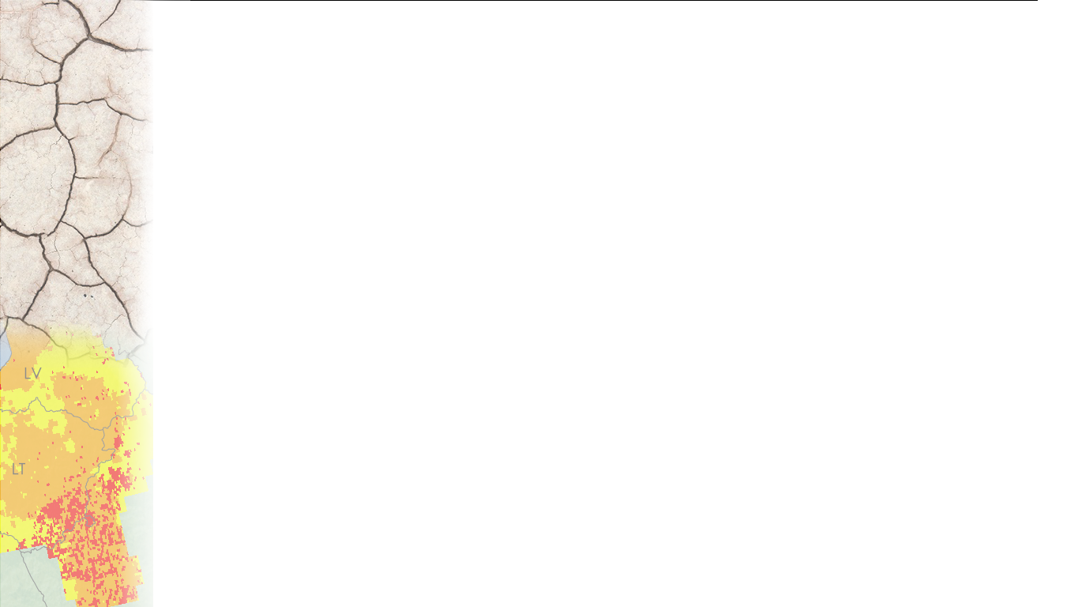

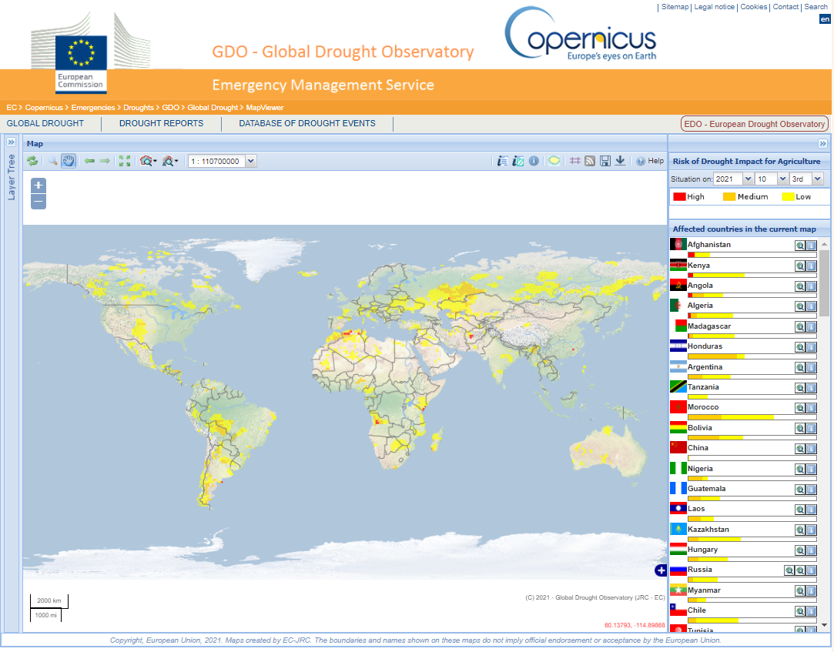
CEMS Drought monitoring service
https://edo.jrc.ec.europa.eu/
GDO = Global Drought Observatory
GDO provides
  Early warning, monitoring and forecasting of droughts and their likely impacts, based on satellite data, hydro-meteorological modelling and in-situ observations.
  Based on a conceptual model of drought risk

Slide 7

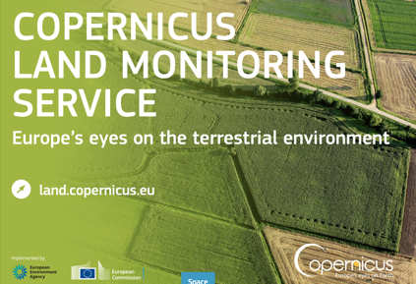
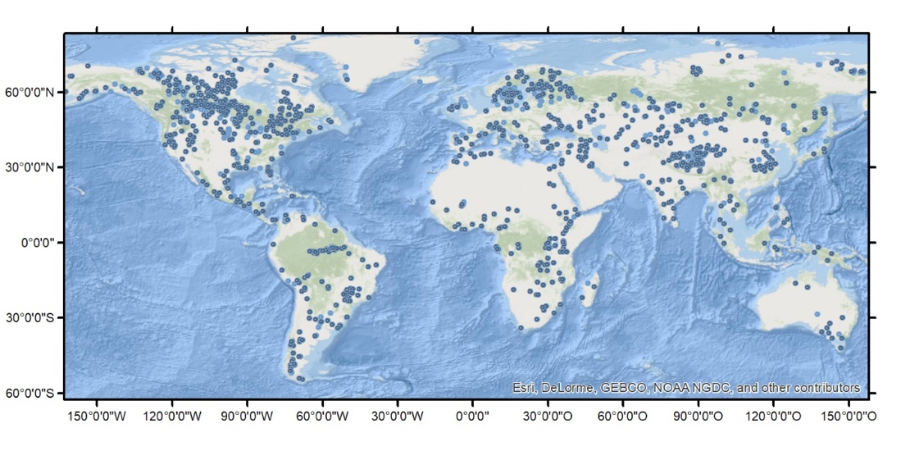
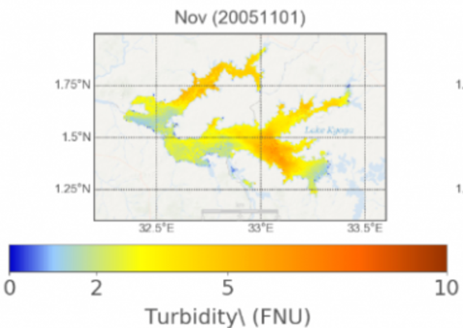
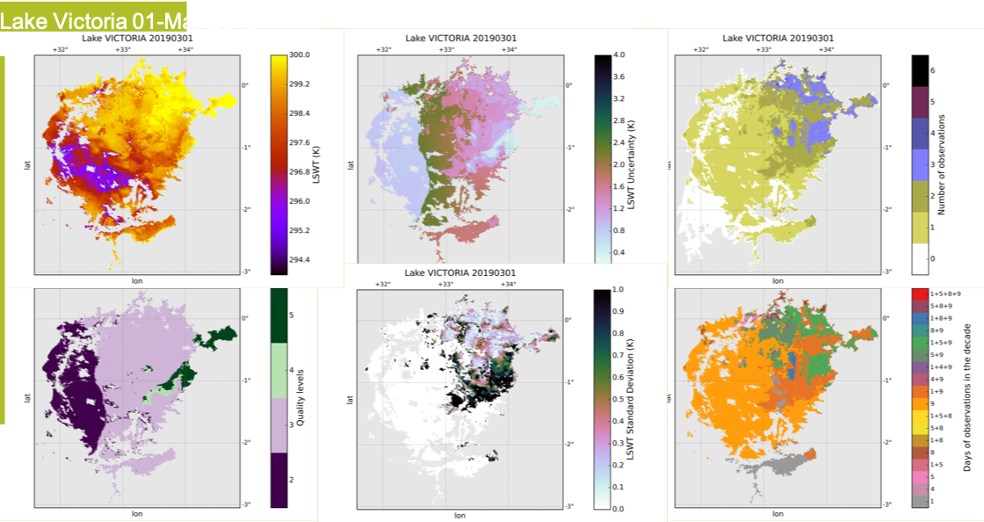
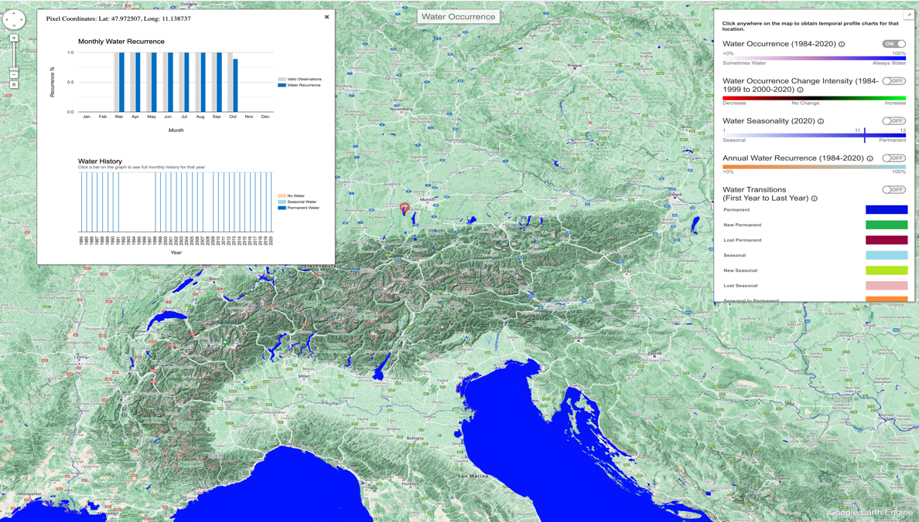
Water Products
Water Bodies global 10-day 100m
Lake Surface Water Temperature global (min 1000lakes) 10day 1km
Lake Water Quality global (4264 lakes) 10day/month 300m /100m
Lake and River Water level global (>10000 stations) 10day/monthly
Water Bodies 100m>20m
Current: Monthly global 100m dynamics (within mask)
GSWE: yearly updates (JRC) with Landsat
Future: uptake GSWE in operational portfolio as WB product
GSWE - algorithm adaptation for S2
quality control
documentation
[2yrs]

Slide 8
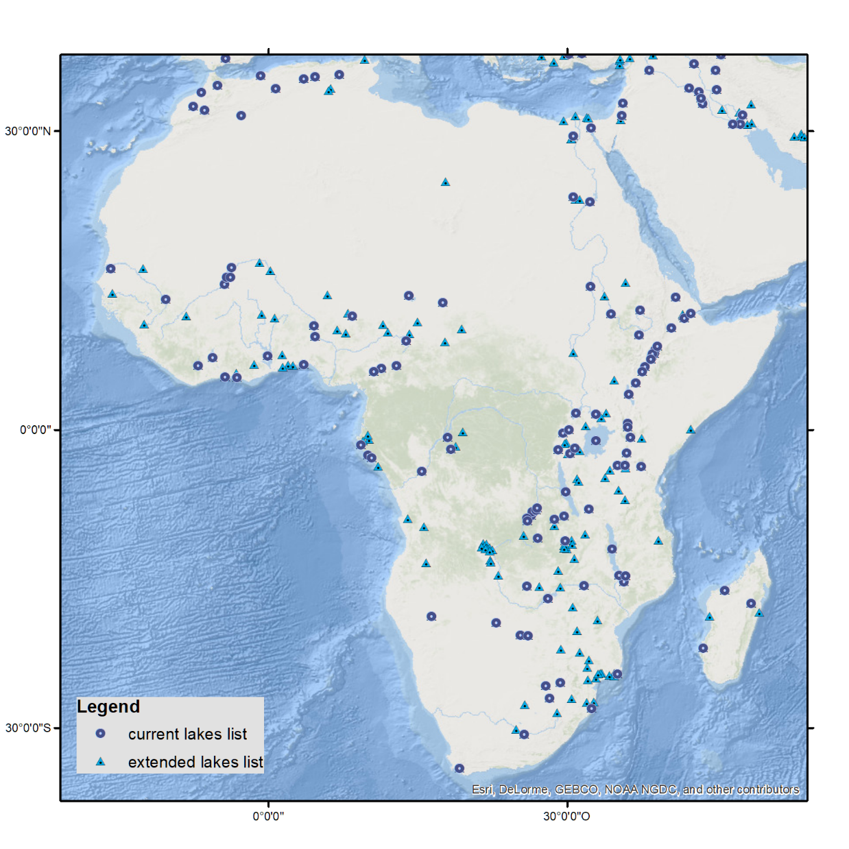
Africa Inland Water Coverage
Country | No. of lakes
Algeria | 5
Angola | 4
Benin | 2
Botswana | 3
Burkina Faso | 2
Burundi | 1
Cameroon | 5
Chad | 8
Democratic Republic of the Congo | 17
Djibouti | 1
Egypt | 11
Ethiopia | 15
Gabon | 7
Ghana | 7
Guinea | 1
Ivory Coast | 5
Kenya | 5
Madagascar | 5
Malawi | 3
Mali | 8
Mauritania | 1
Morocco | 4
Mozambique | 12
Namibia | 1
Nigeria | 9
Rwanda | 4
Senegal | 2
Somalia | 1
South Africa | 13
South Sudan | 2
Sudan | 5
Togo | 2
Tunisia | 1
Uganda | 8
United Republic of Tanzania | 15
Zambia | 12
Zimbabwe | 2

Slide 9
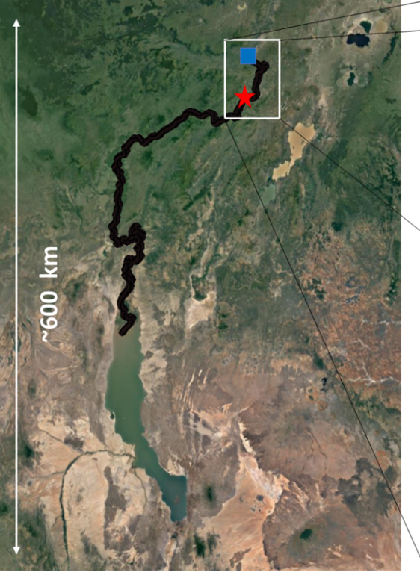

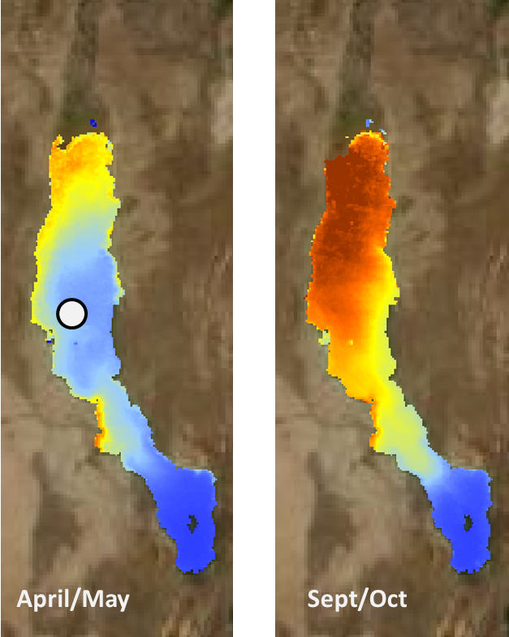
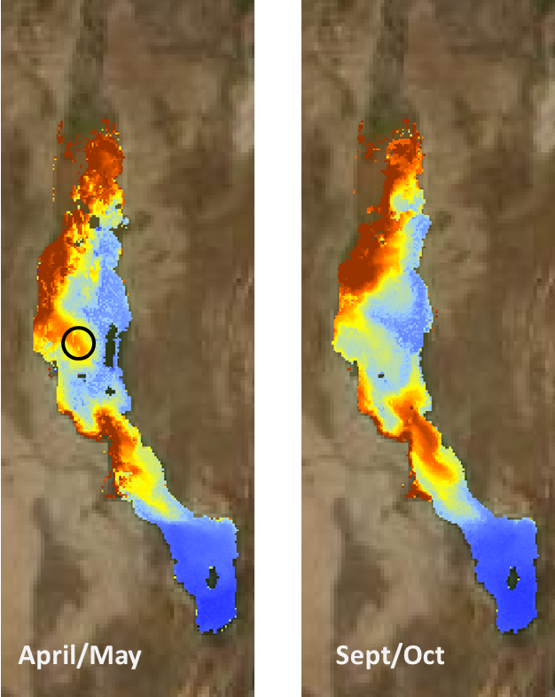
Water Quality for SDG 6.
Water Quality product: +-4500 lakes at 300m (turbidity, trophic state, reflectance)
Turbidity data over 10 years
seasonal trends
NRT Turbidity data - 2018
Parameters
  Lake Surface Water Temperature (LSWT)
  Turbidity (TUR)
  Trophic State Index (TSI)
  Lake Surface Reflectances (LSR)
Lake Turkana, Kenya
Spatial resolution
  300m, 1km, 100m (in evolution)
Temporal aggregation
  10days for water LSWT, TUR and TSI
Time span
  2002-2012 (MERIS + AATSR) –
  2016-ongoing (OLCI + SLSTR)

Slide 10
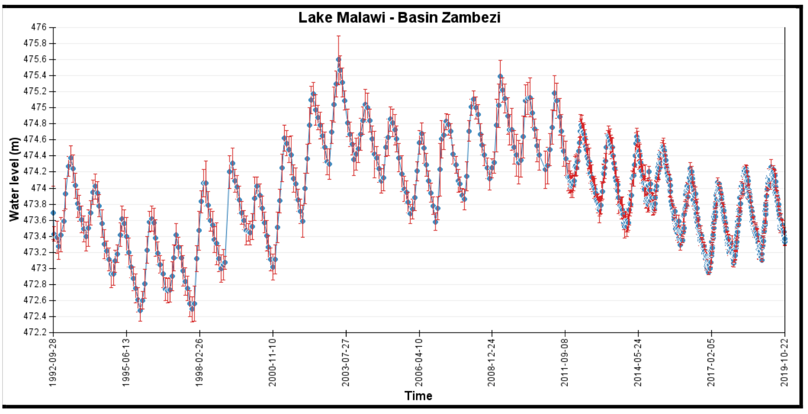
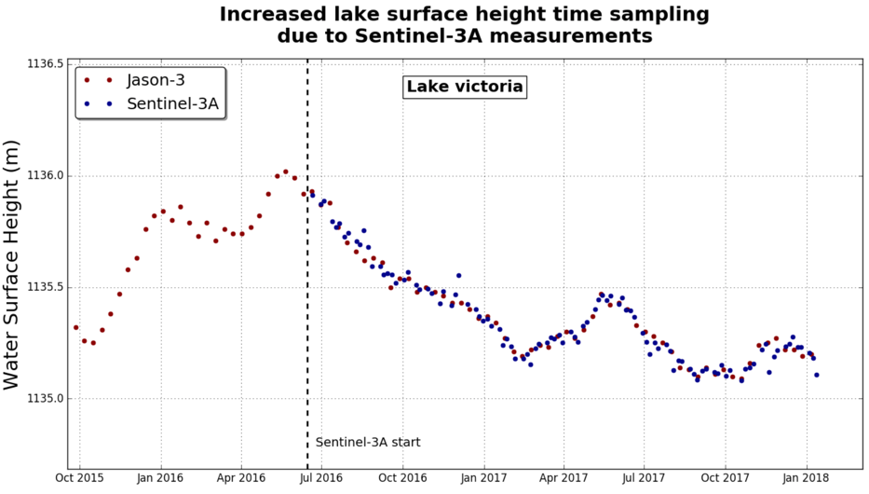
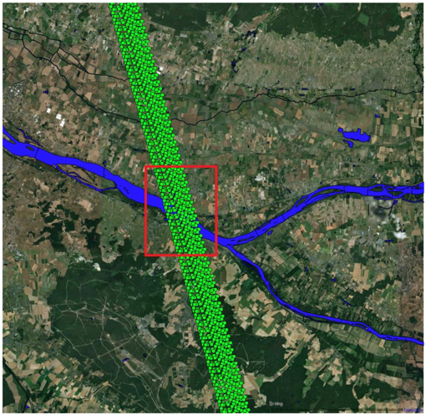
Water Products
Water Bodies global 10-day 100m
Lake Surface Water Temperature global (min 1000lakes) 10day 1km
Lake Water Quality global (4264 lakes) 10day/month 300m /100m
Lake and River Water level global (>10000 stations) 10day/monthly
Current: 10000+ virtual stations
Future: adding S6
Expanding no of stations

Slide 11
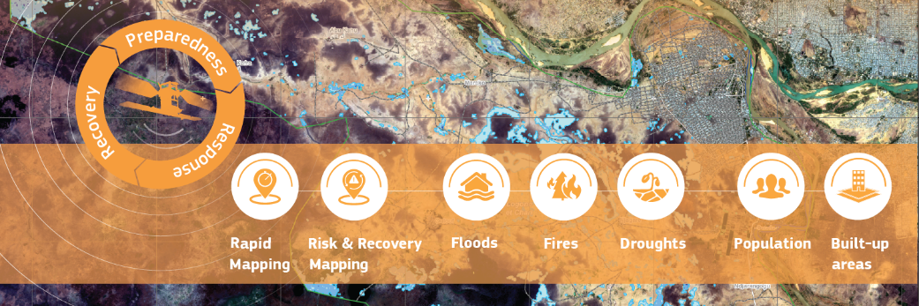
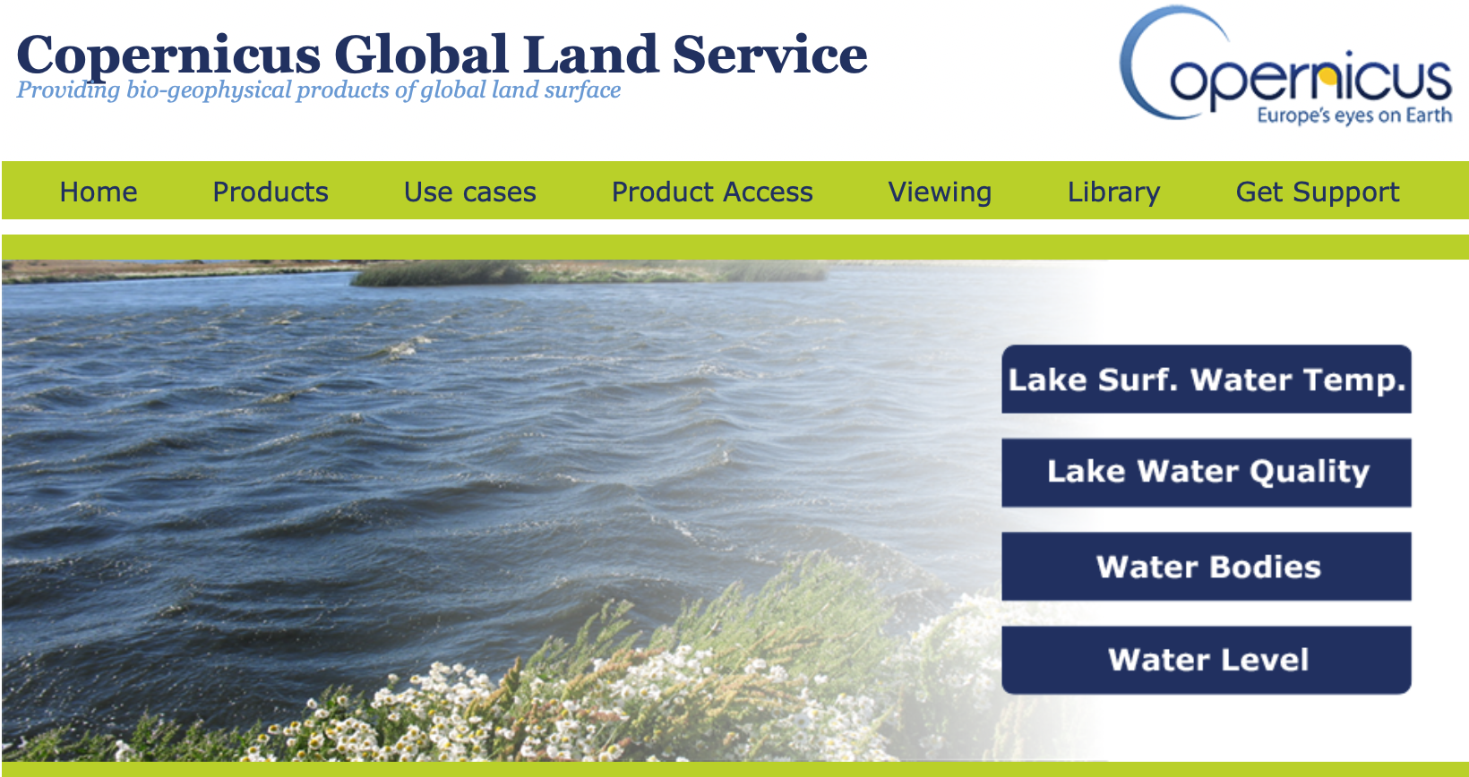
All services and products presented are free and open for everyone!
&
Emergency
Land monitoring
https://emergency.copernicus.eu/
https://land.copernicus.eu/

